Slide 1
W0: HTML/CSS
Samvit Das
Evan Kim

Slide 2
Our first workshop:
Making your Catbook profile!

Slide 3
Catbook
The purrfect social media website

Slide 4


Your Tools
Code Editor
Terminal/Git Bash (for windows)
weblab.is/hw0

Slide 5
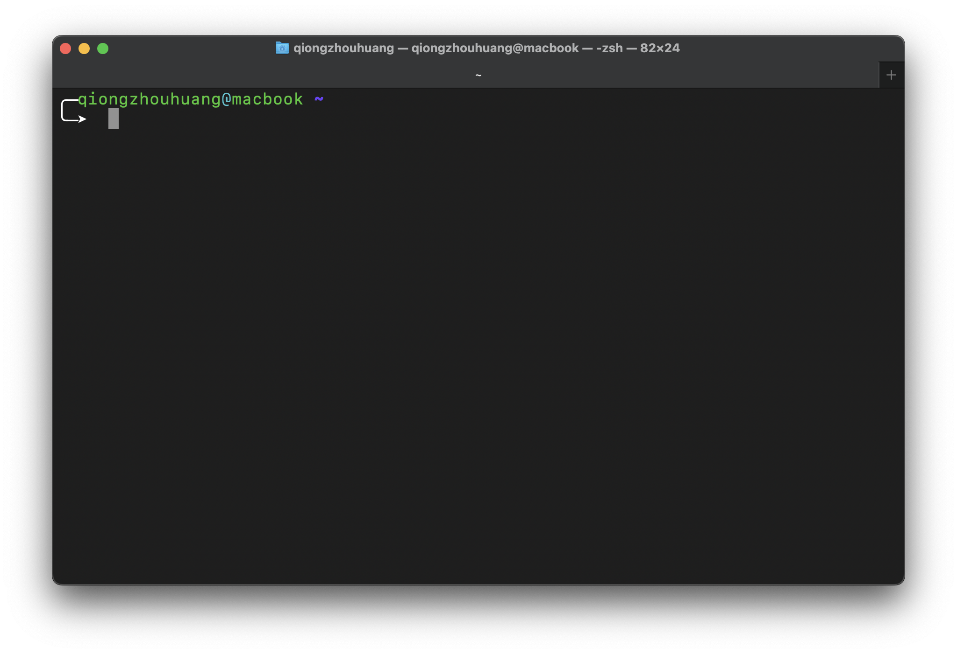
Open Console

Slide 6
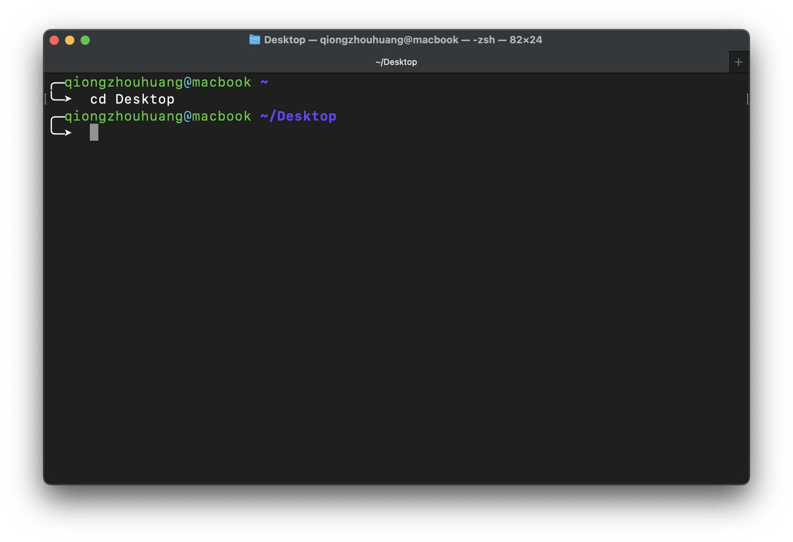
Open Console

Slide 7
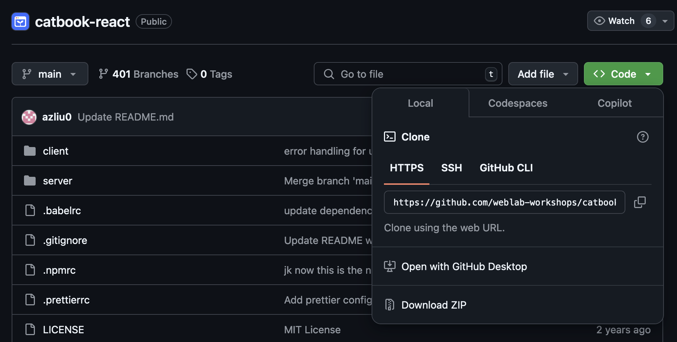
Git the Workshop!
Cloning the repository! (we did this earlier!)
weblab.is/catbook
1
2
Notes:
was done earlier today

Slide 8
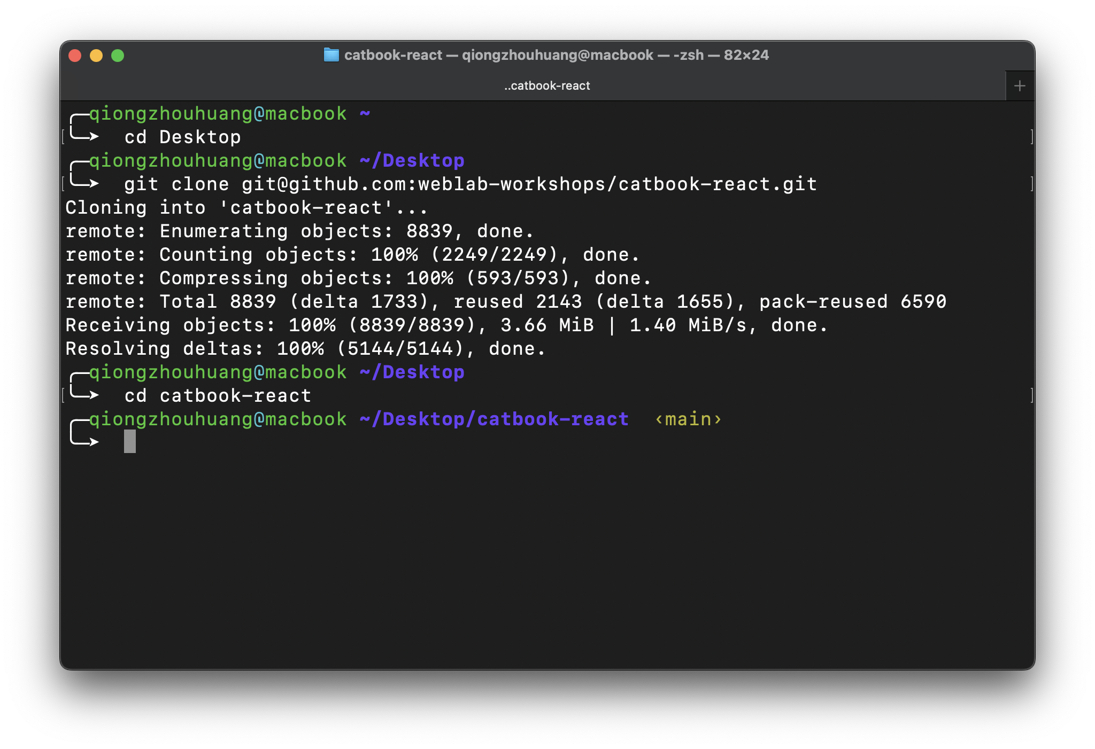
Git the Workshop!
git clone https://github.com/weblab-workshops/catbook-react.git

Slide 9
Git the Workshop!
git clone https://github.com/weblab-workshops/catbook-react.git
cd catbook-react

Slide 10
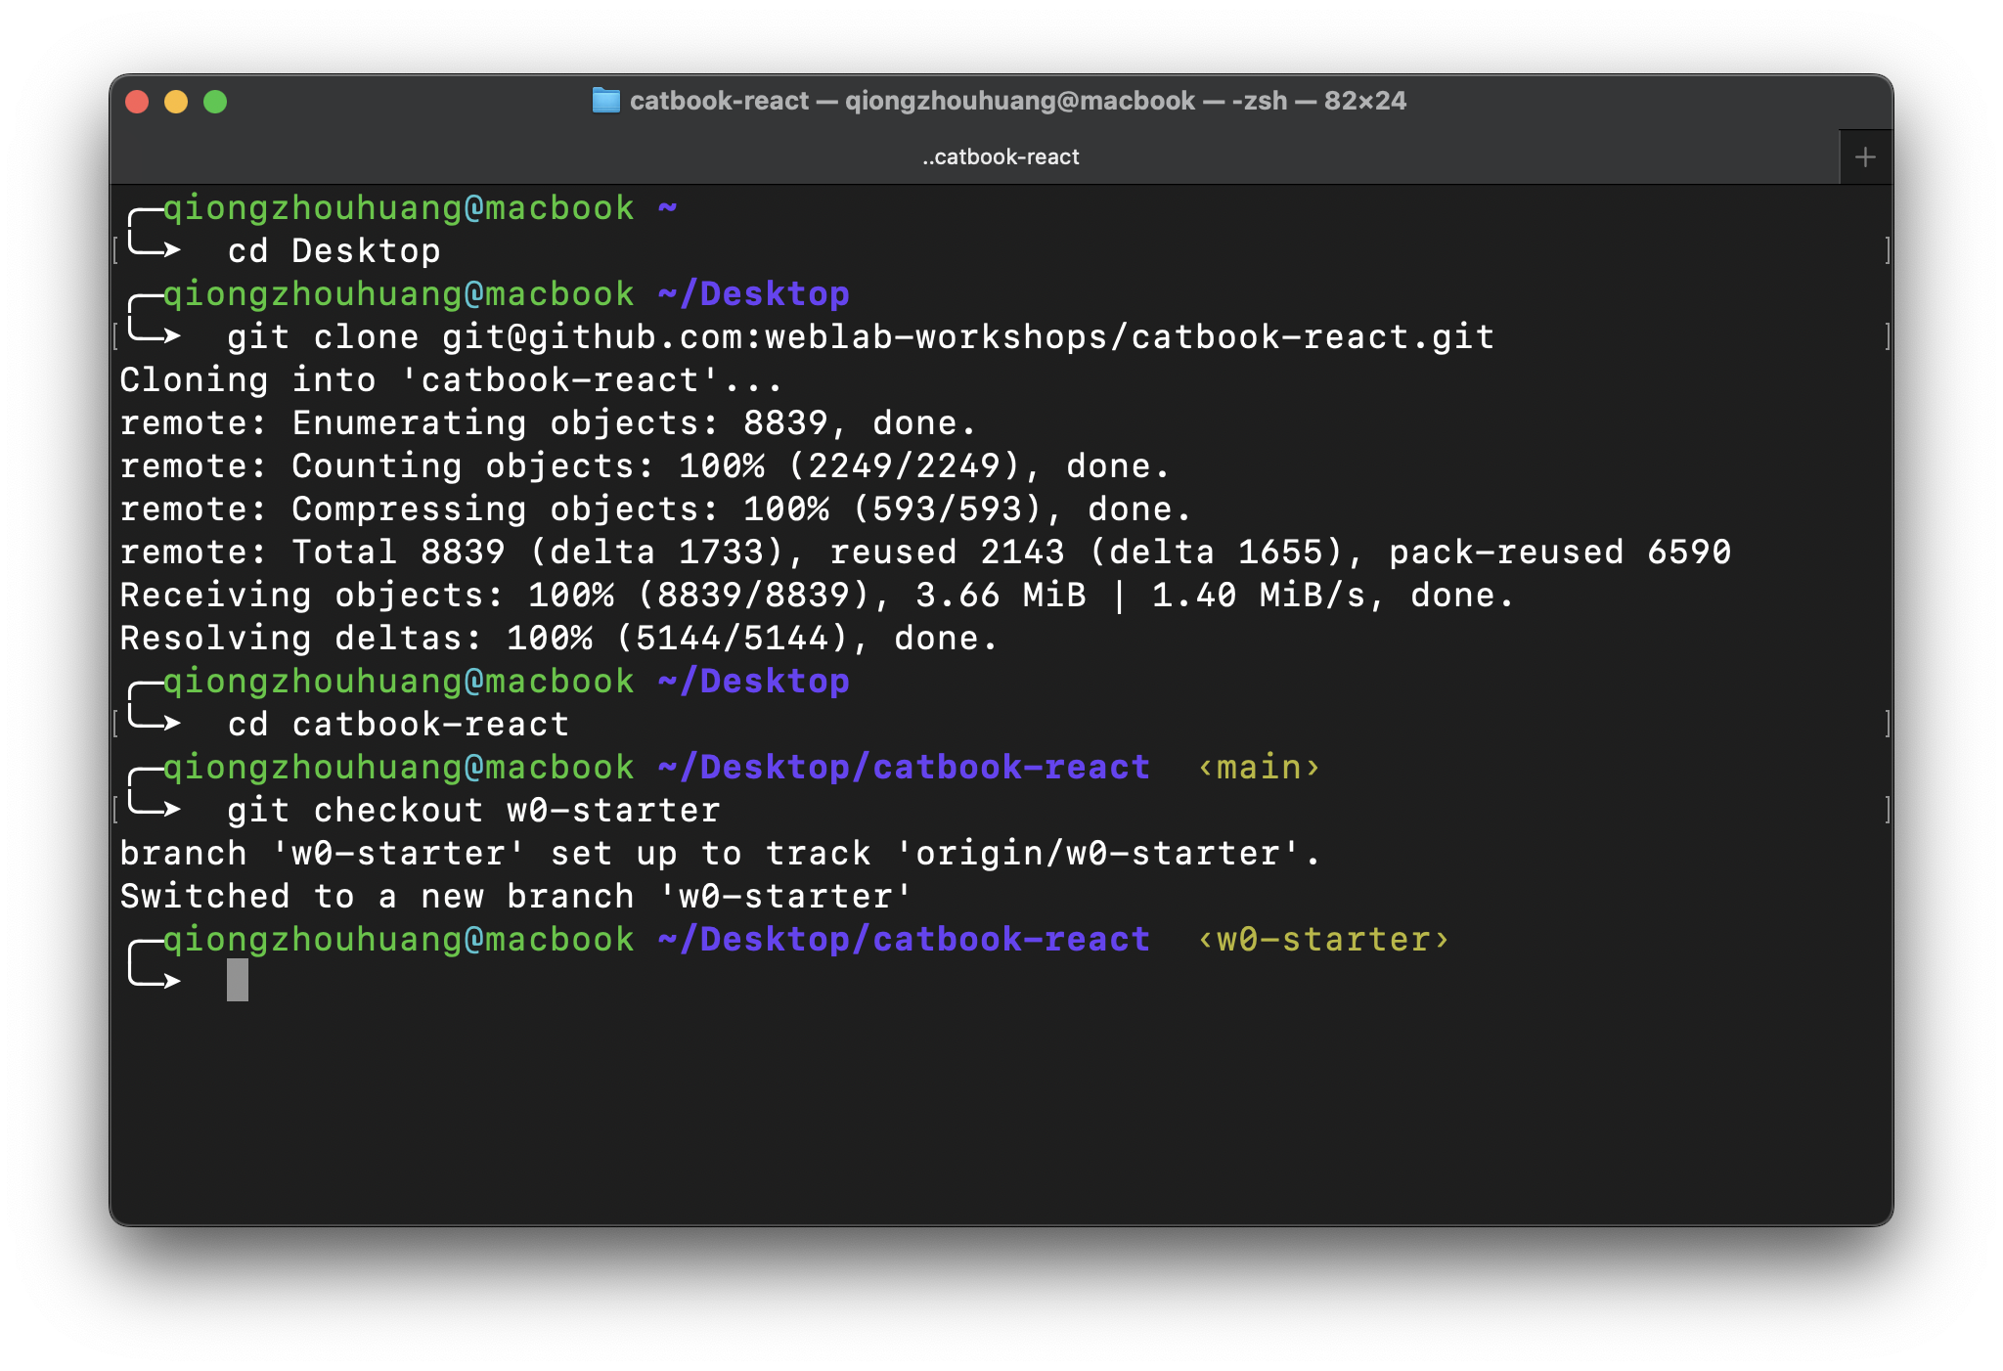
Git the Workshop!
git clone https://github.com/weblab-workshops/catbook-react.git
cd catbook-react
git checkout w1-starter

Slide 11
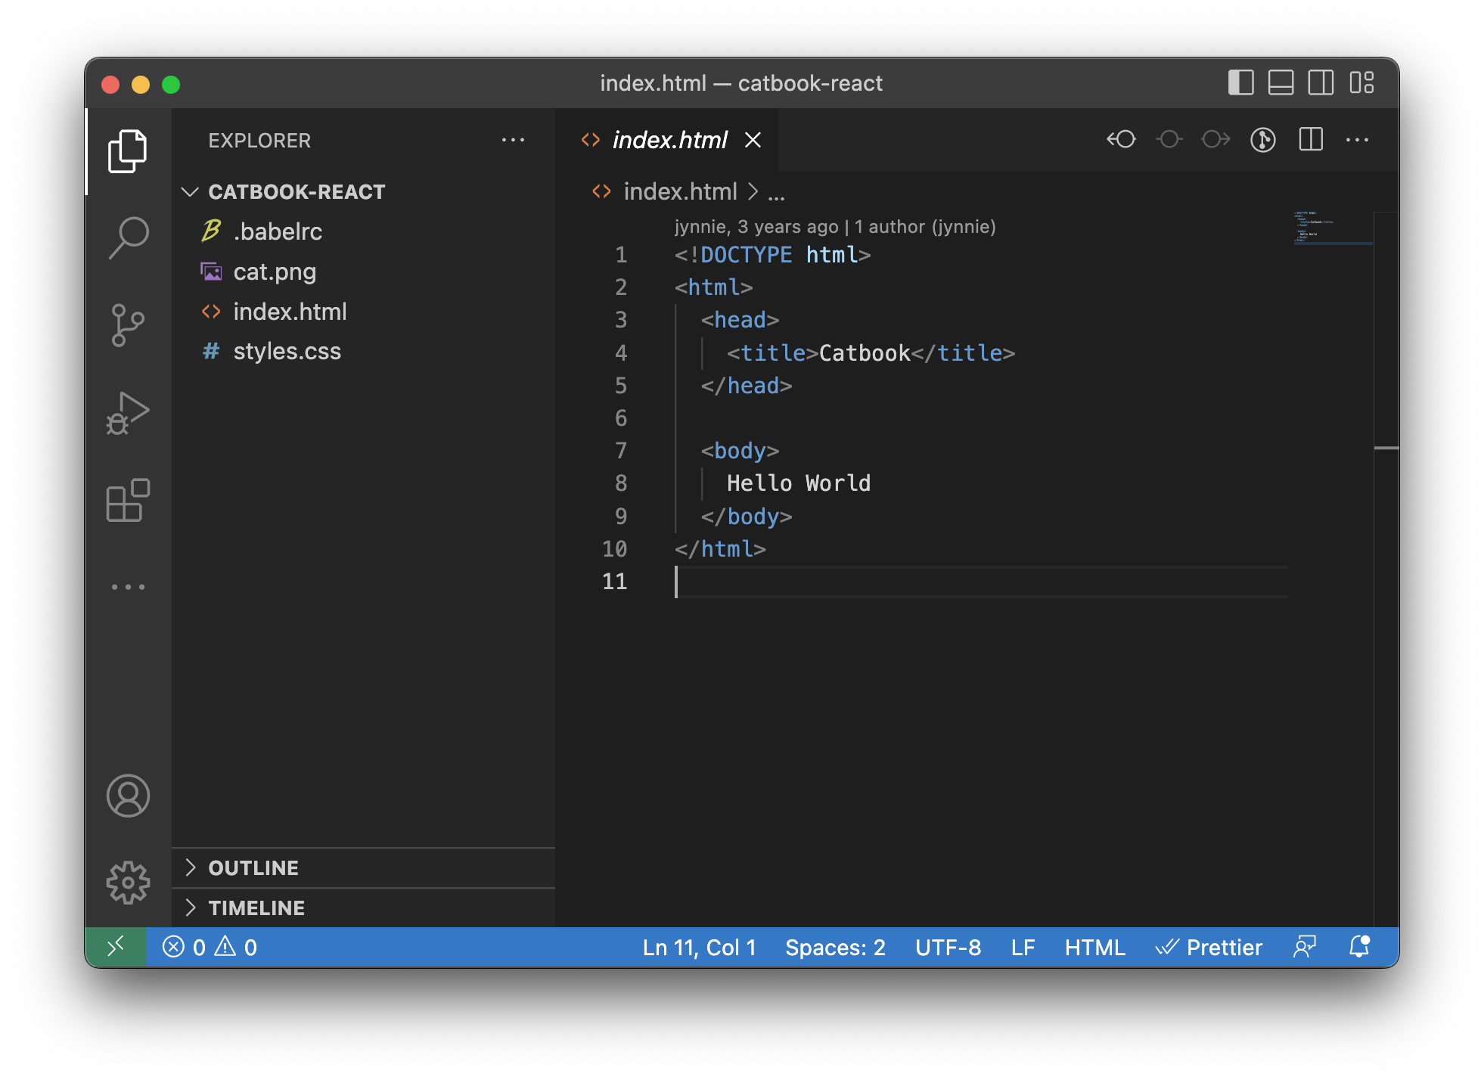
Open the Workshop on Visual Studio Code
Notes:
2021-w0-* is the new syntax

Slide 12
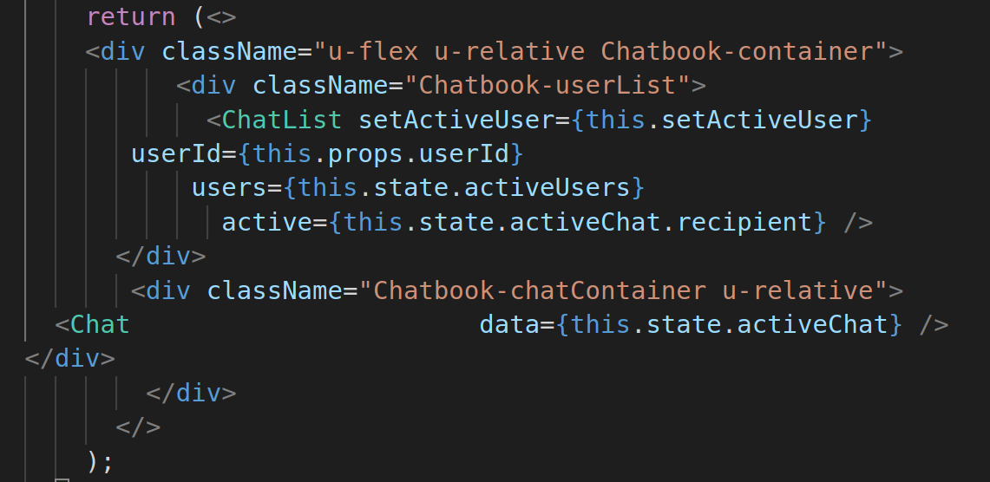
Pretty indentation/formatting is hard

Slide 13
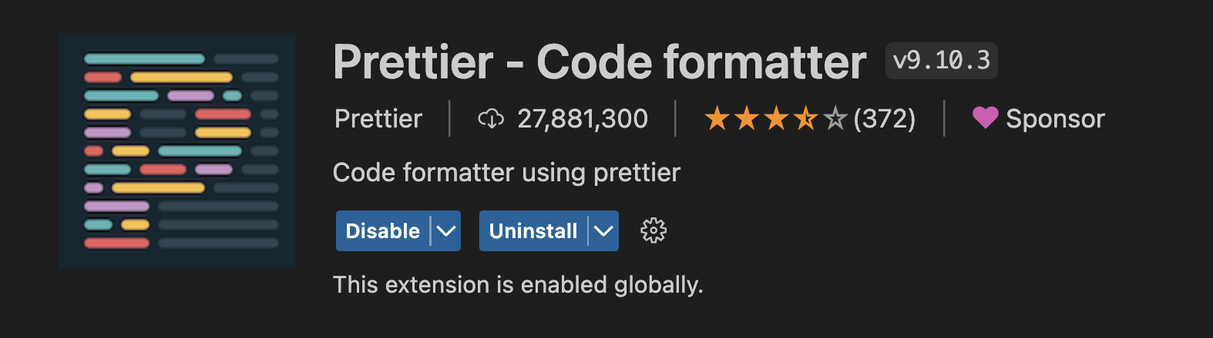
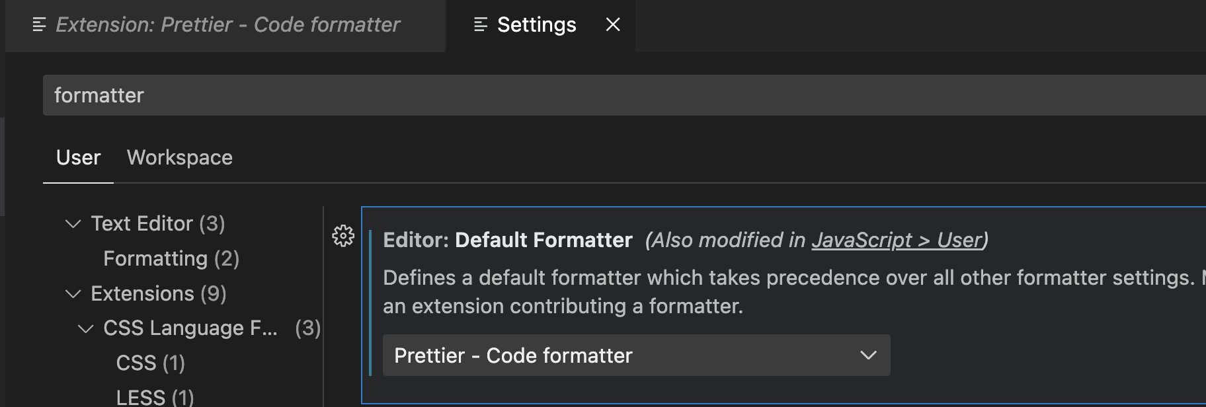
Introducing Prettier!
VSCode extension
Makes your code pretty every time you hit “save”
Careful…make sure that everyone is using Prettier when checking this!

Slide 14
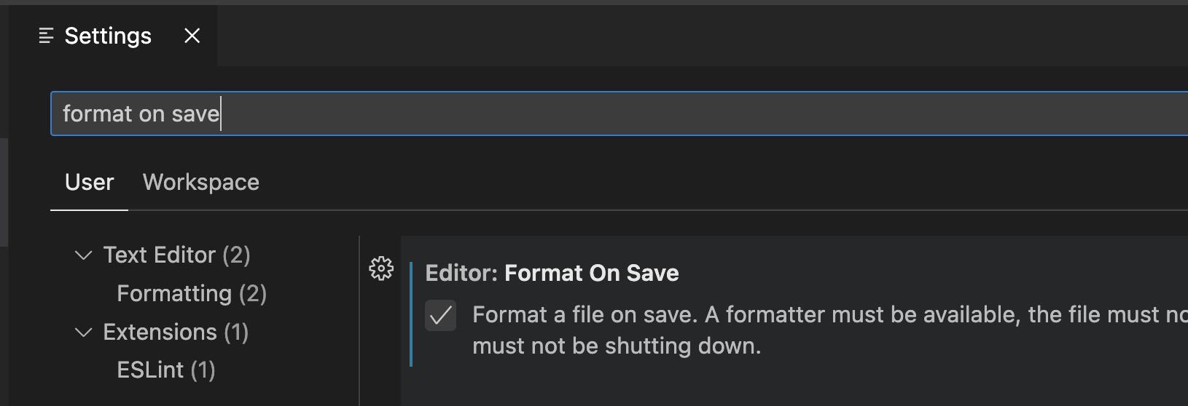
Format on Save

Slide 15
Old code

Slide 16
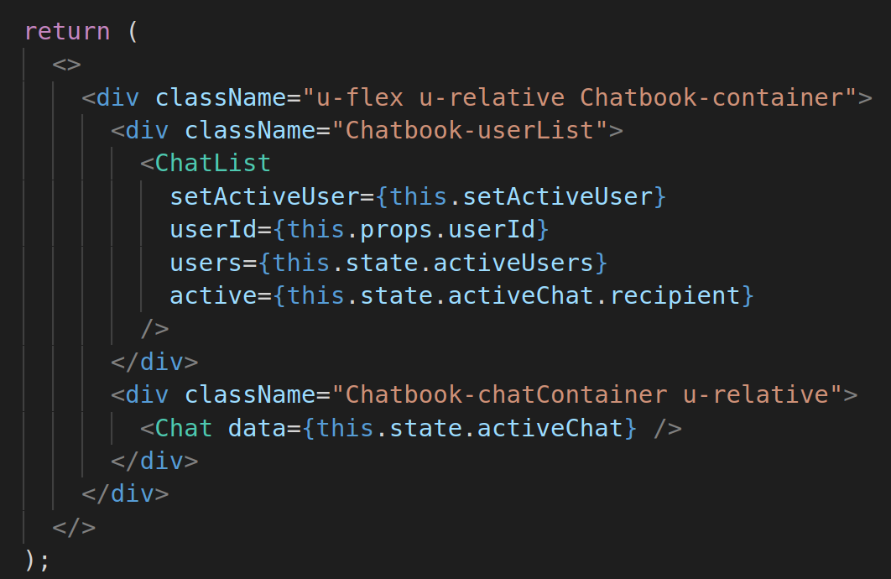
After Ctrl+S

Slide 17
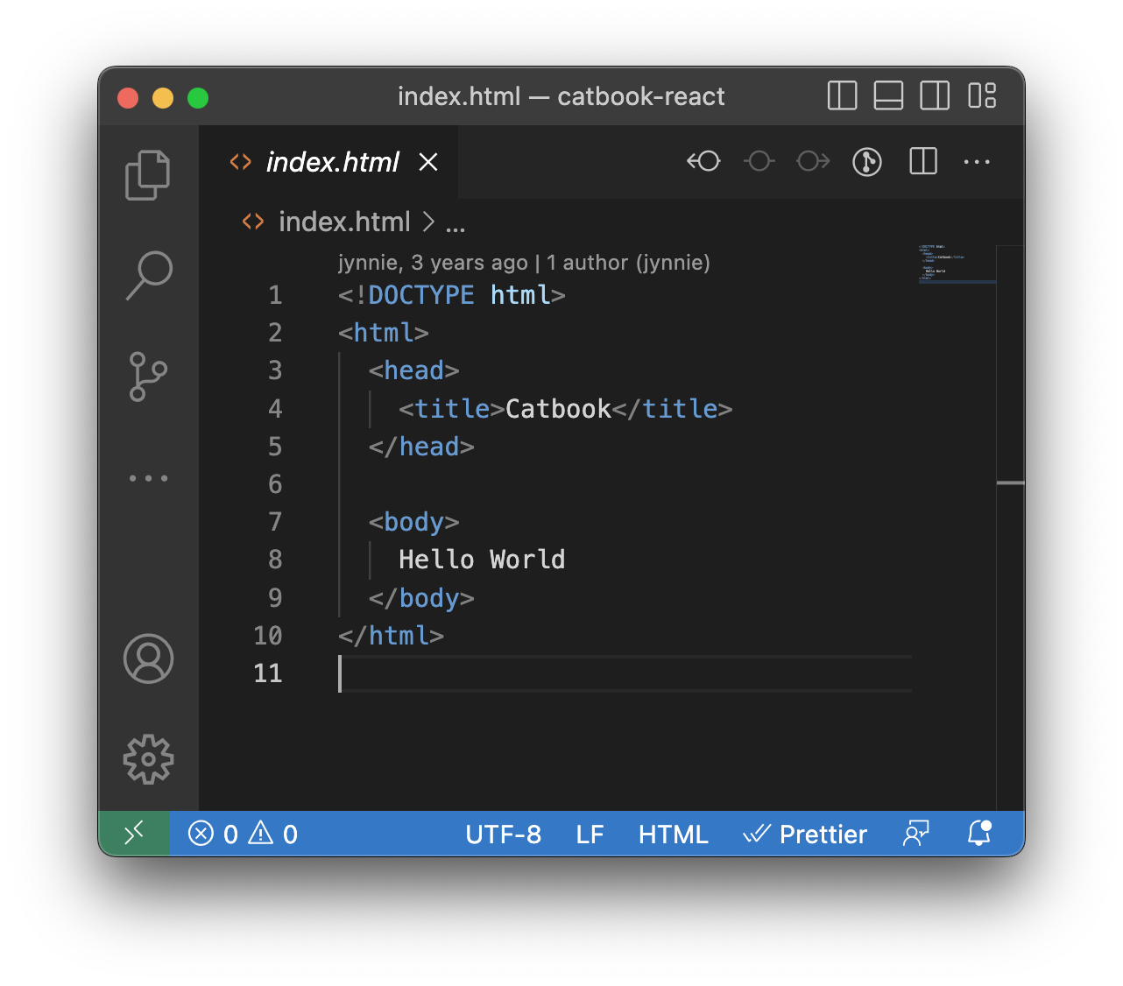
Let’s look at the code!

Slide 18
But first…
A coloring scheme!

Slide 19
Let’s look at the site!

Slide 20
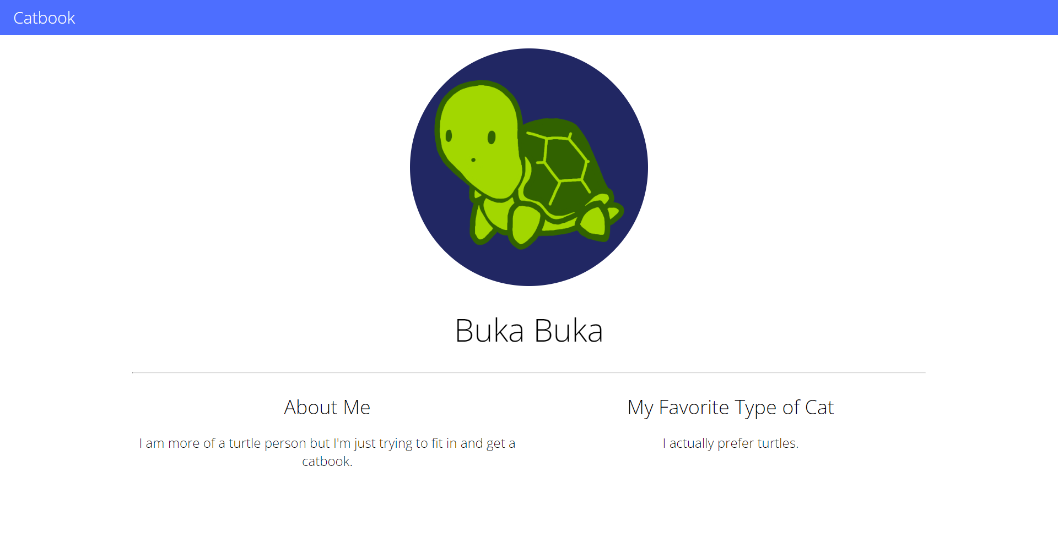
👀 our goal
Notes:
This may seem like a lot but let’s break it down into HTML/CSS components

Slide 21
Let’s Begin!
buckle up…
workshop 3 progress
workshop 0 progress
starter
starter
step1
step2
complete
complete

Slide 22
Step 0:
Barebones HTML
(Exercise!)
git reset --hard
git checkout w0-starter
workshop 3 progress
workshop 0 progress
starter
starter
step1
step2
complete
complete

Slide 23
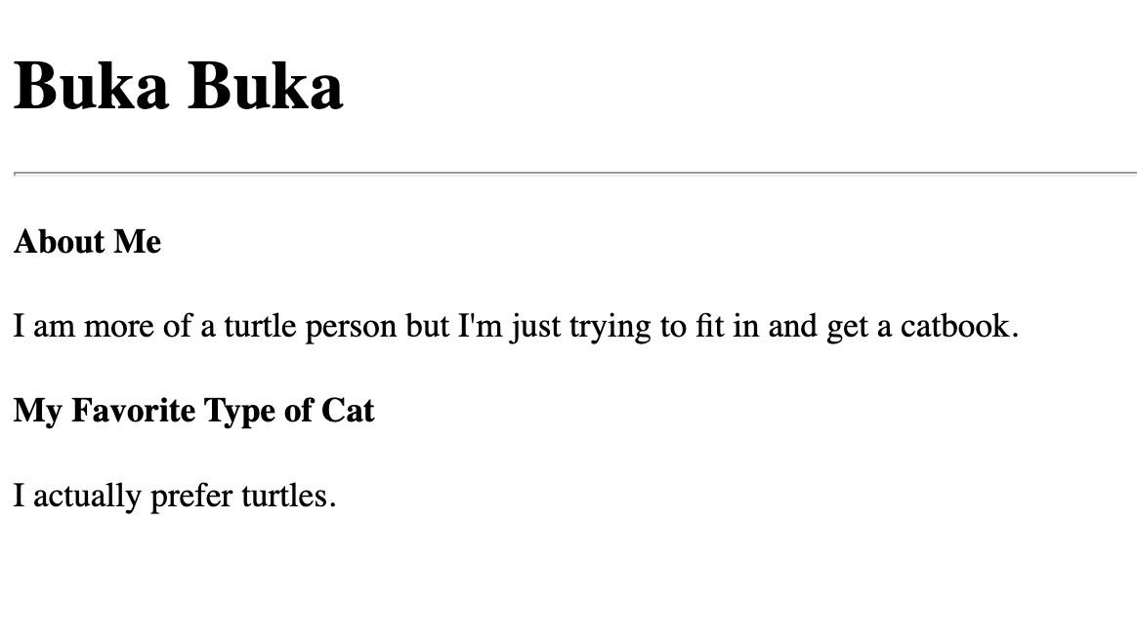
Let’s do the HTML!
Step 1: Add some text!
Hint: Recall the <html>, <h1>, <p> and <div> tags. Perhaps some others such as <section> might be useful... 🤔

Slide 24
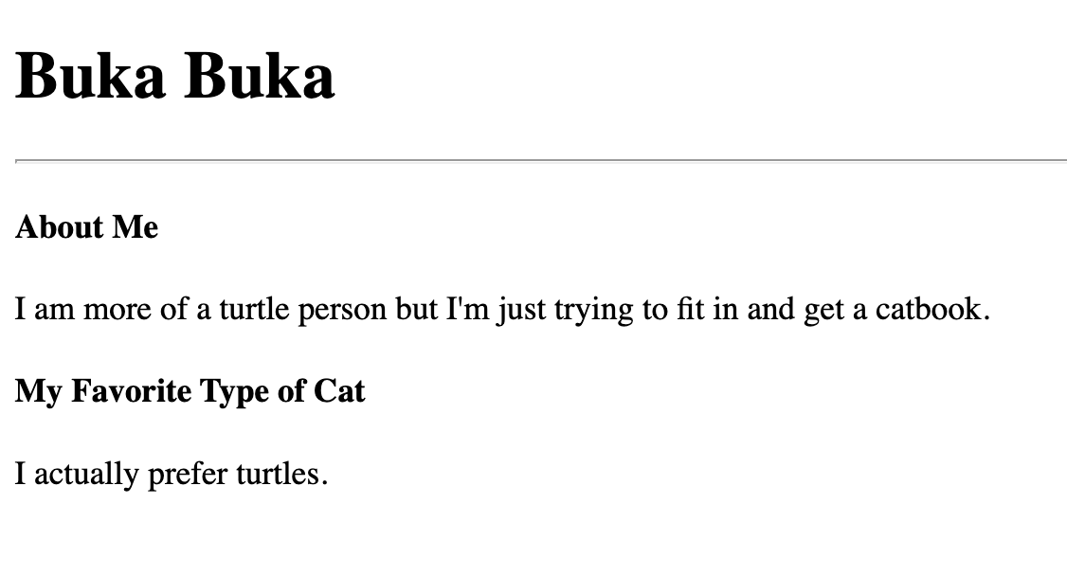
Exercise 1: Kitten Started
Let’s try adding some text about us in index.html!
Recall the <html>, <h1>, <p> and <div> tags.
Perhaps some others such as <section> or <hr> might be useful... 🤔
Notes:
Although this may not look like our catbook right now, it is! It is simply the catbook’s content without any styling (css) applied to it.

Slide 25
Need Help?
Raise your hand or add yourself to weblab.is/q
Notes:
Although this may not look like our catbook right now, it is! It is simply the catbook’s content without any styling (css) applied to it.

Slide 26
Exercise 1: Kitten Started
git reset --hard (clears your local changes)
git checkout w0-step1
Notes:
This is just so that you guys will catch up to what step I’m doing while coding…we can talk about what these commands mean later but tldr: git reset --hard clears all changes and git checkout get you to a specific step

Slide 27
brief git clarification / review
Why do we keep doing
git reset --hard
and
git checkout wX-stepY
like… what do these commands even do again...

Slide 28
git reset --hard
resets the LOCAL version of your code (on your computer) to match the last COMMITED version of the code
irreversibly deletes all local (uncommitted) changes

Slide 29
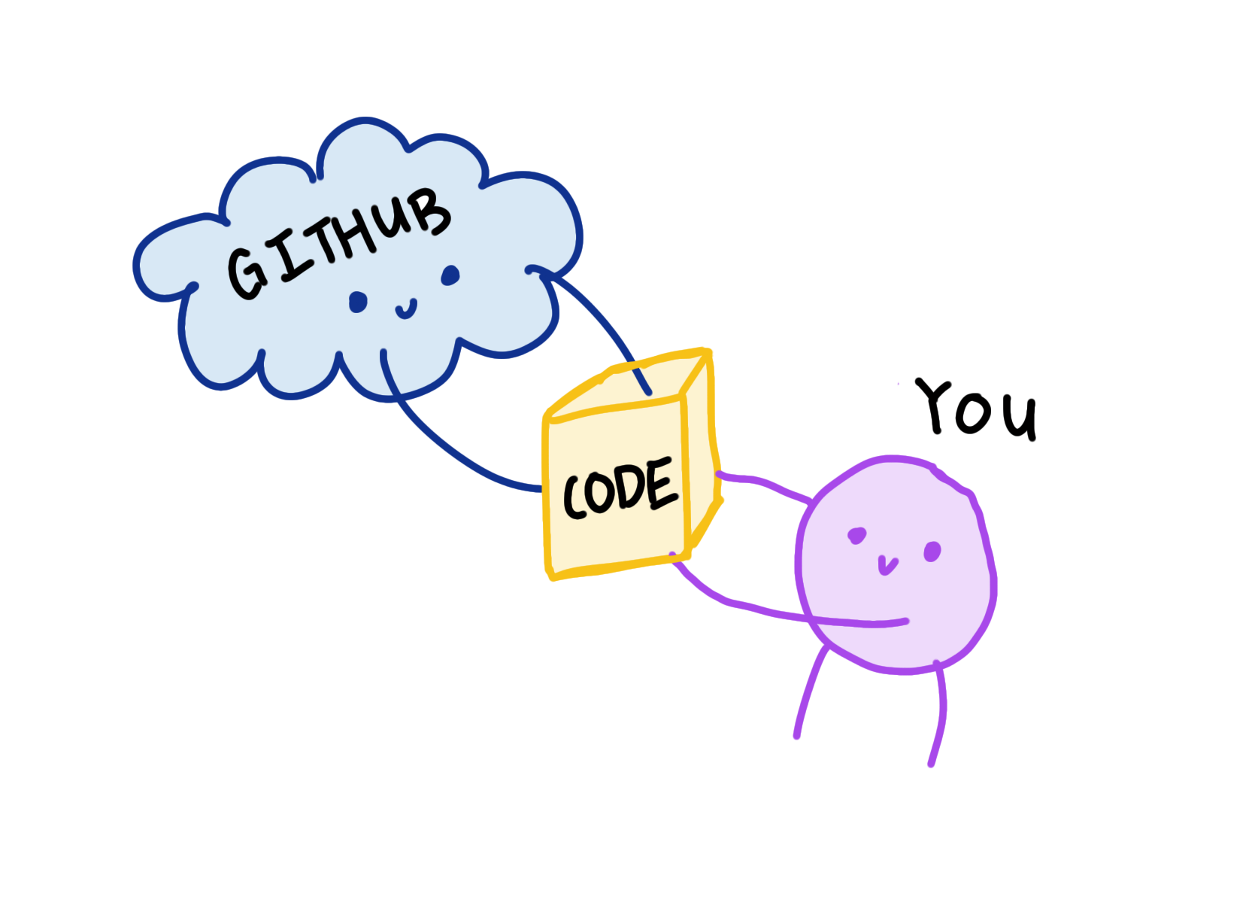

Slide 30
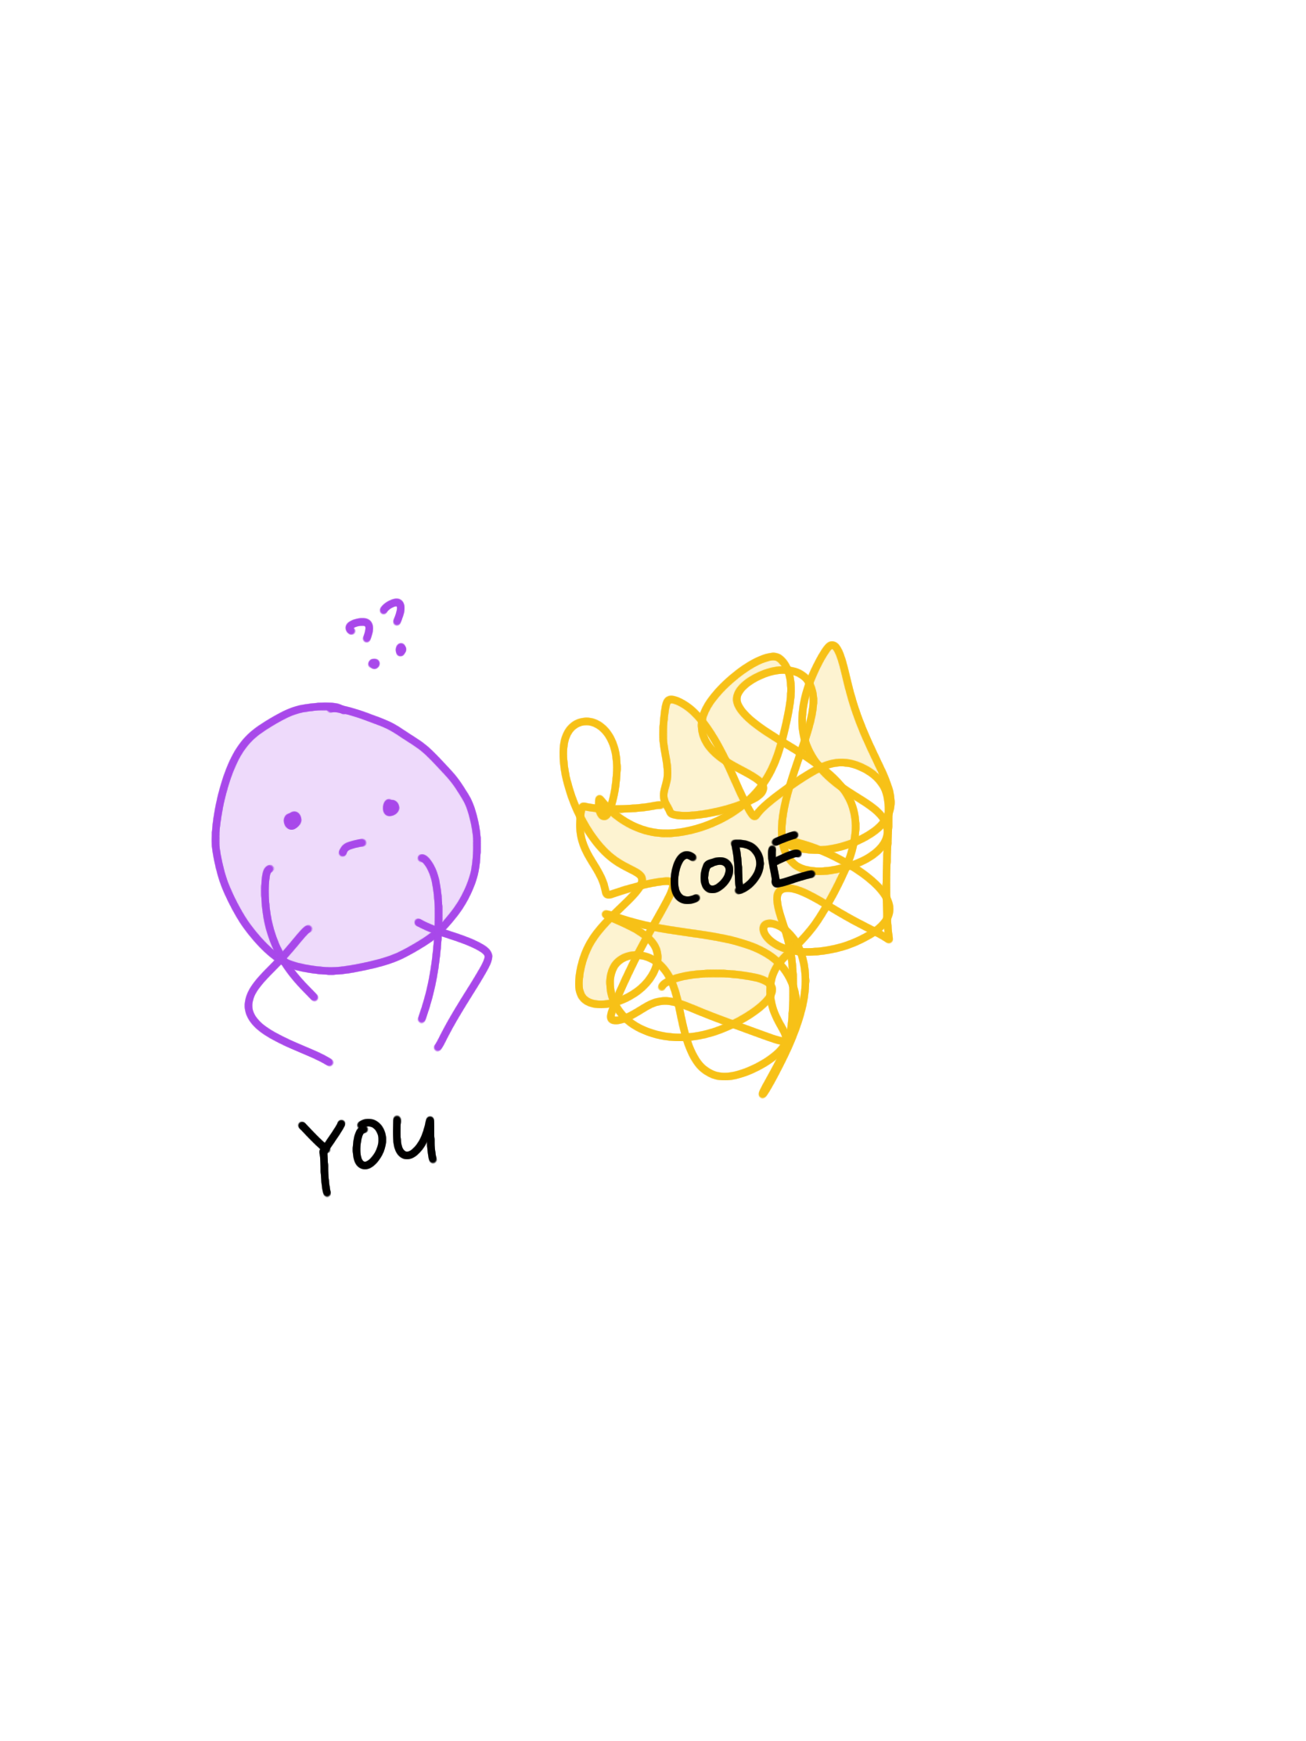
many minutes later...
man… i wish i could just restore the code to the original working version but I’d have to press “undo” like 10,000 times and vscode won’t even let me do that...

Slide 31

git reset --hard

Slide 32
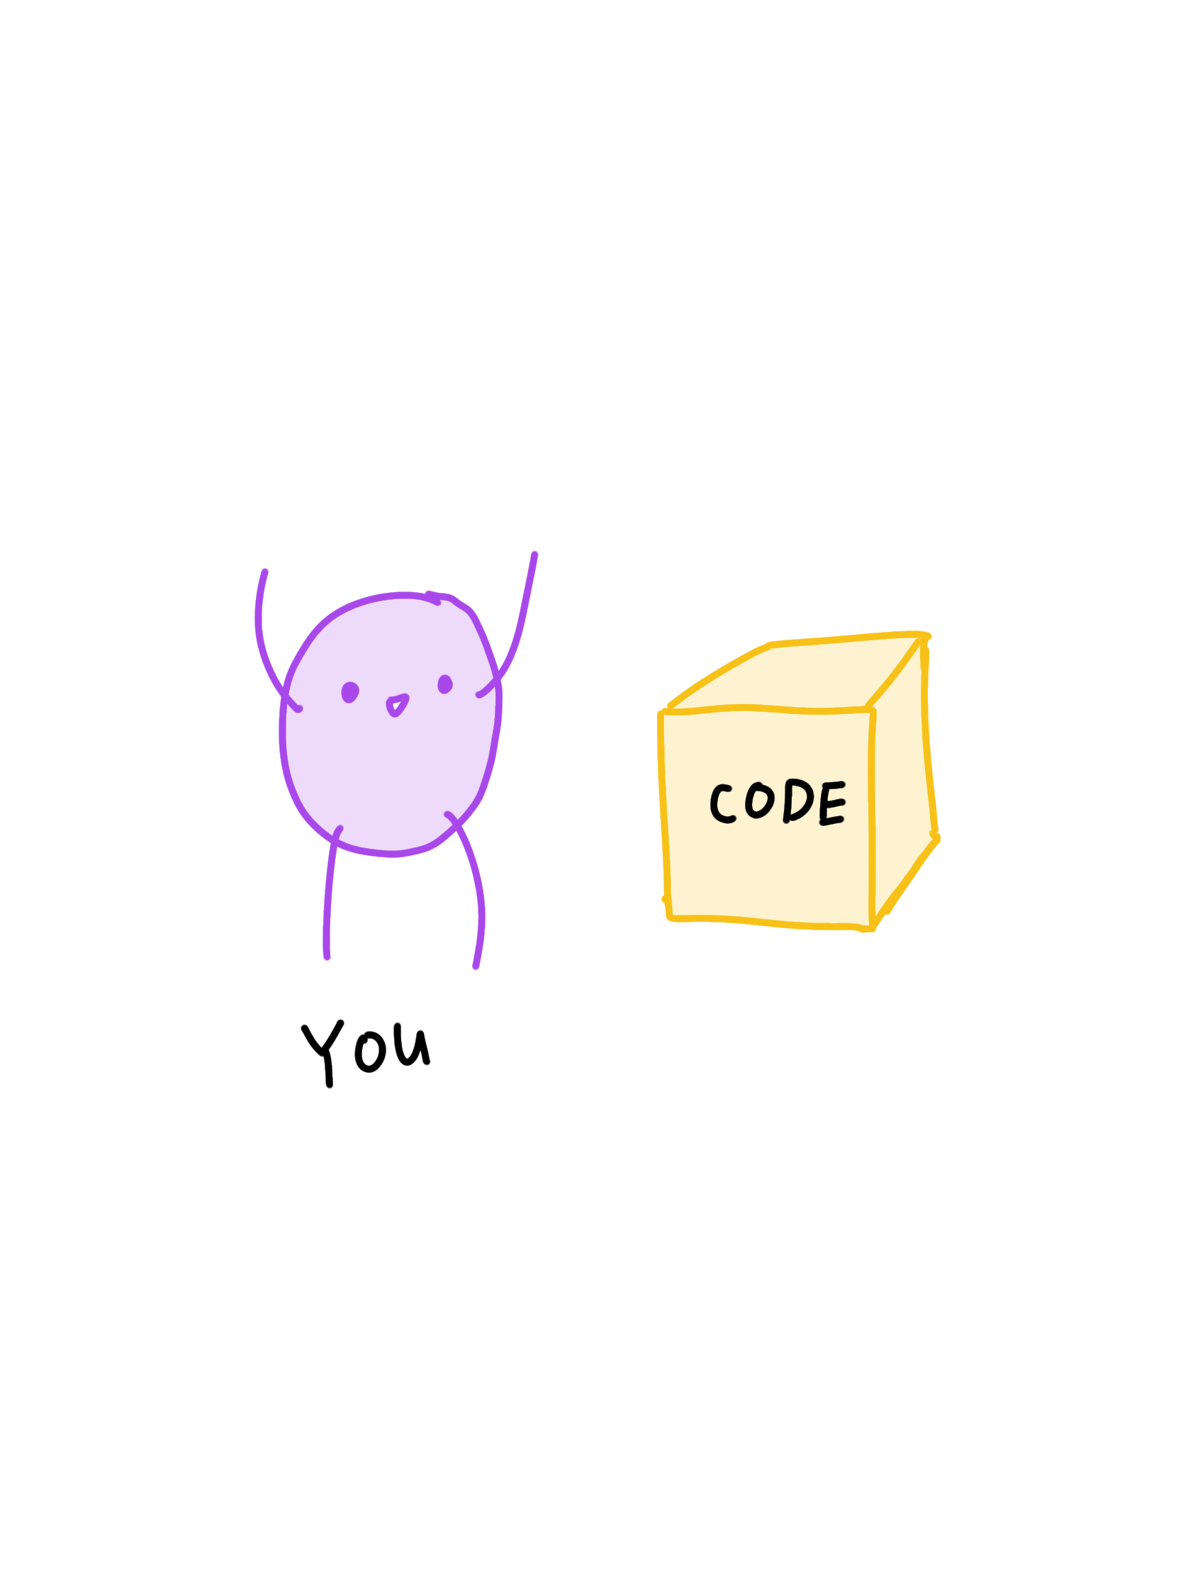

Slide 33
git checkout wX-stepY
retrieves the branch “wX-stepY” from the cloud (github)

Slide 34
our workflow:
note!
If you get lost, or fall behind:
git reset --hard
git checkout wX-stepY
This is good for our workshops, but not when building your projects! Don’t abuse git reset —hard. Better ways to switch branches.

Slide 35
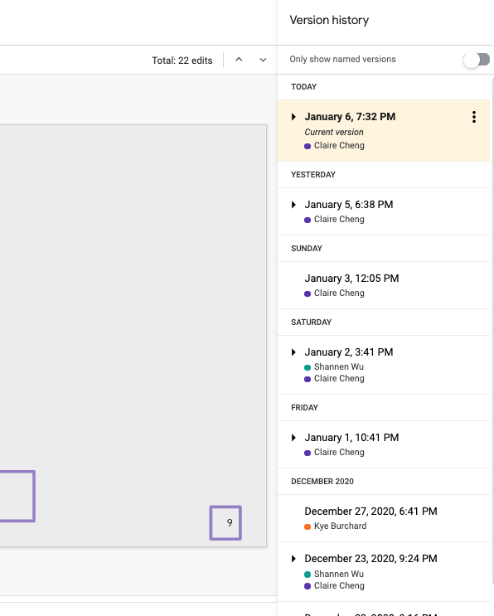
going through version history of a google doc and selecting a specific version to “restore”
→ it’s the same idea!

Slide 36
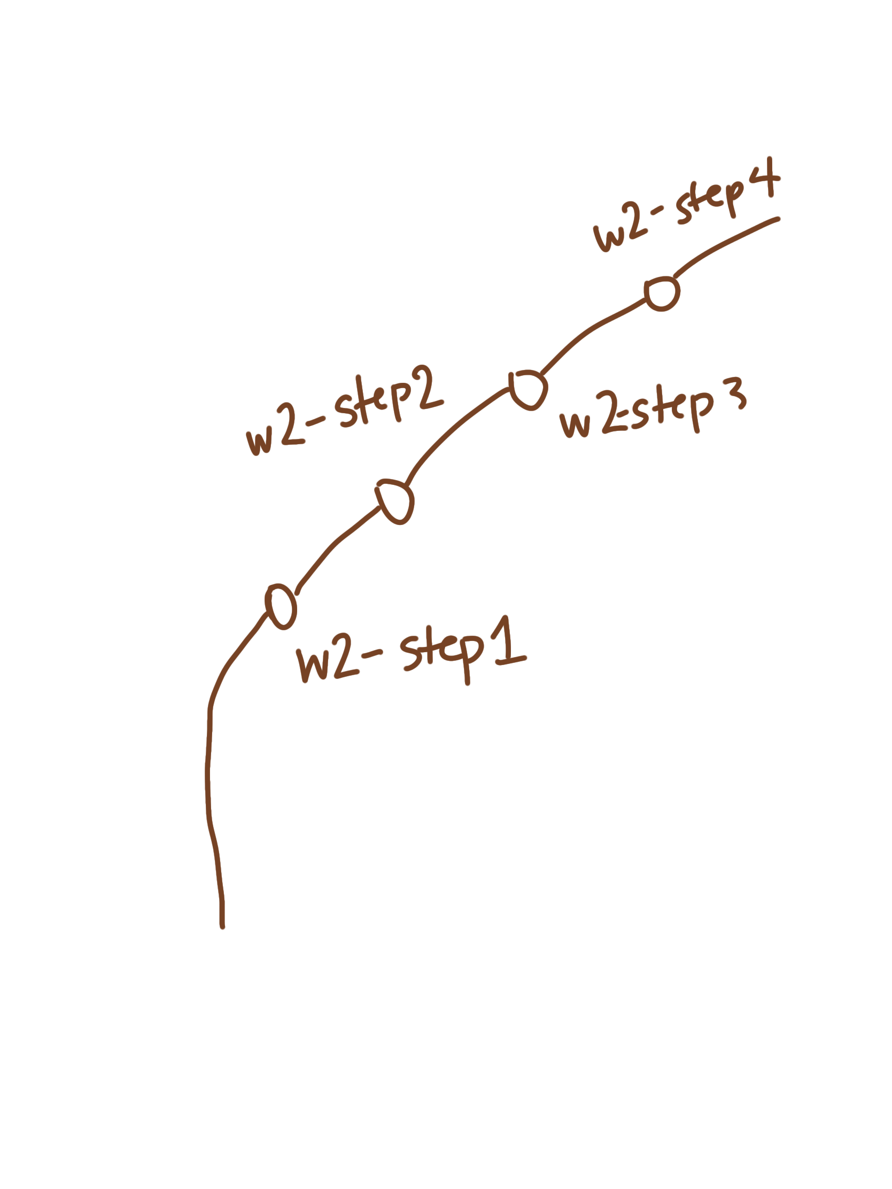
we want to “check out” a particular version of the code.
(in this case, it’s an individual step of our workshop.)

Slide 37
Exercise 1: Kitten Started
git reset --hard (clears your local changes)
git checkout w0-step1
Notes:
This is just so that you guys will catch up to what step I’m doing while coding…we can talk about what these commands mean later but tldr: git reset --hard clears all changes and git checkout get you to a specific step

Slide 38
Step 1:
Add an Image
git reset --hard
git checkout w0-step1
workshop 3 progress
workshop 0 progress
starter
starter
step1
step2
complete
complete

Slide 39
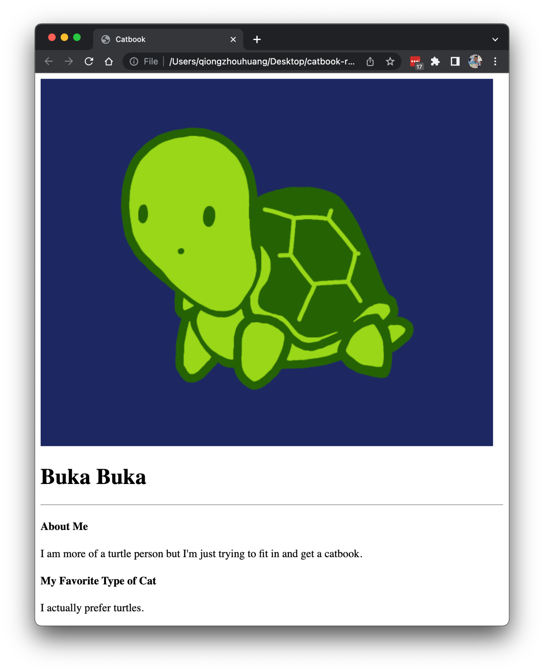
Exercise 2: Cute Turtles
git reset --hard
git checkout w0-step1
Let’s add a profile picture with alt text to index.html!
Hint! Recall the <img> tag and its attributes?

Slide 40
Step 2:
Centering HTML
git reset --hard
git checkout w0-step2
workshop 3 progress
workshop 0 progress
starter
starter
step1
step2
complete
complete

Slide 41
Centering HTML
git reset --hard
git checkout w0-step2

Slide 42
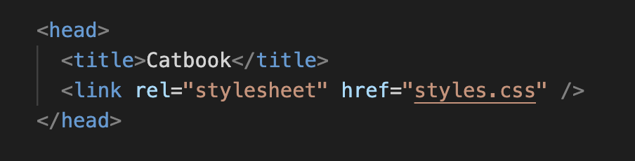
Making it Stylish
git reset --hard
git checkout w0-step2
It’s time to link to our CSS stylesheet!

Slide 43
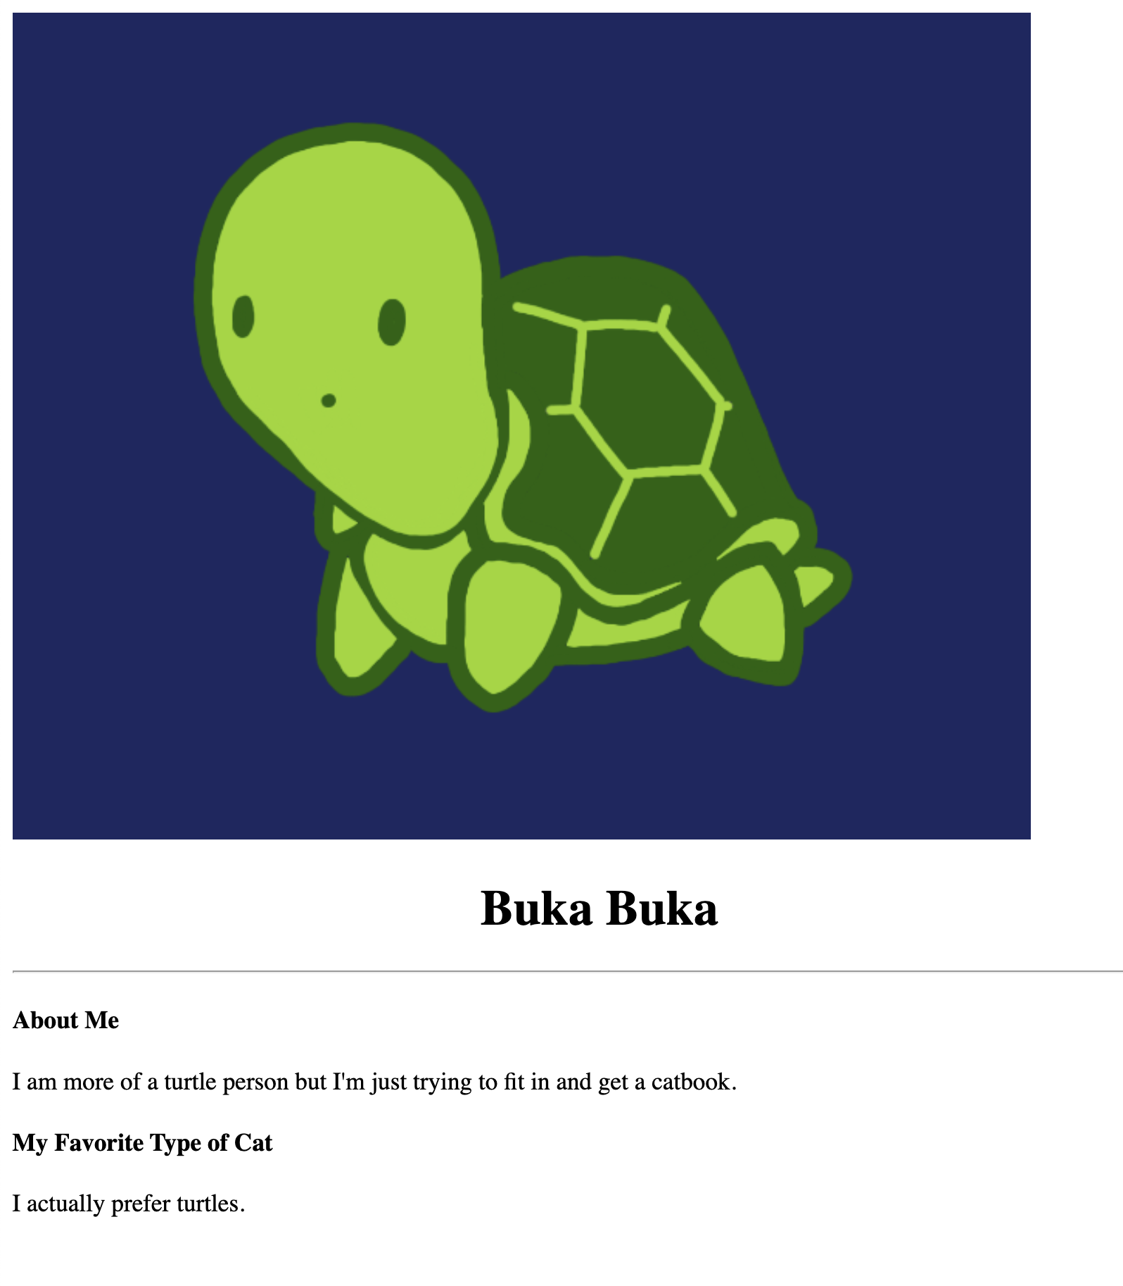
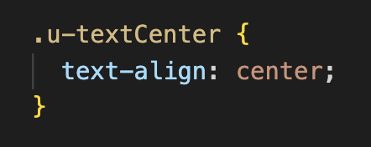
Making it Stylish
git reset --hard
git checkout w0-step2
Let’s center the text together!

Slide 44
Making it Stylish
git reset --hard
git checkout w0-step2
git reset --hard
git checkout w0-step2
We call these kinds of classes that just apply one css attribute, utility classes.

Slide 45
Making it Stylish
git reset --hard
git checkout w0-step2
We call these kinds of classes that just apply one css attribute, utility classes.
We’ll format our utility classes so that they’re prefaced by a “u-”

Slide 46
Step 3:
Centerpiece
git reset --hard
git checkout w0-step3
workshop 3 progress
workshop 0 progress
starter
starter
step1
step2
complete
complete

Slide 47
Making it Stylish
git reset --hard
git checkout w0-step3

Slide 48
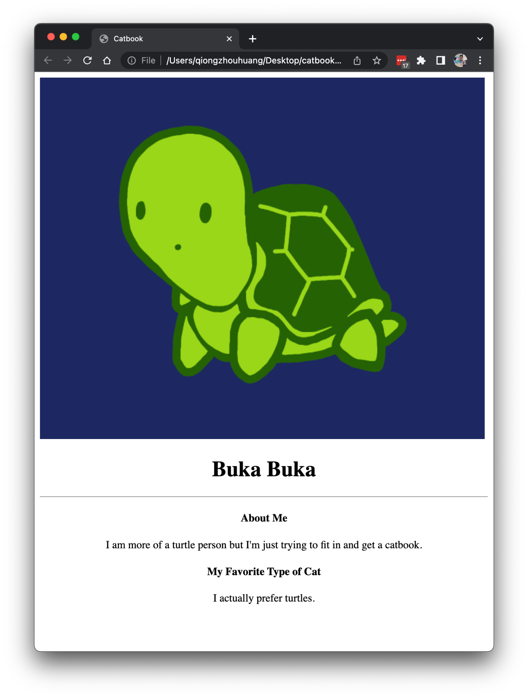
Exercise 3: Centerpiece
git reset --hard
git checkout w0-step3
Use u-textCenter to center the other text!

Slide 49
Exercise 3: Centerpiece
git reset --hard
git checkout w0-step3

Slide 50
More CSS!
Step 4: Center more text with our new ruleset!

Slide 51
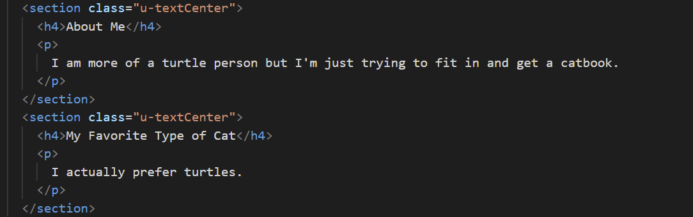
Review:
git reset --hard
git checkout w0-step3

Slide 52
Review:
git reset --hard
git checkout w0-step3
Notes:
Divided by sections

Slide 53
Step 4:
Importing Fonts
git reset --hard
git checkout w0-step4
workshop 3 progress
workshop 0 progress
starter
starter
step1
step2
complete
complete

Slide 54
Importing Fonts
git reset --hard
git checkout w0-step4
We’re slowly getting there! Let’s change fonts now.

Slide 55
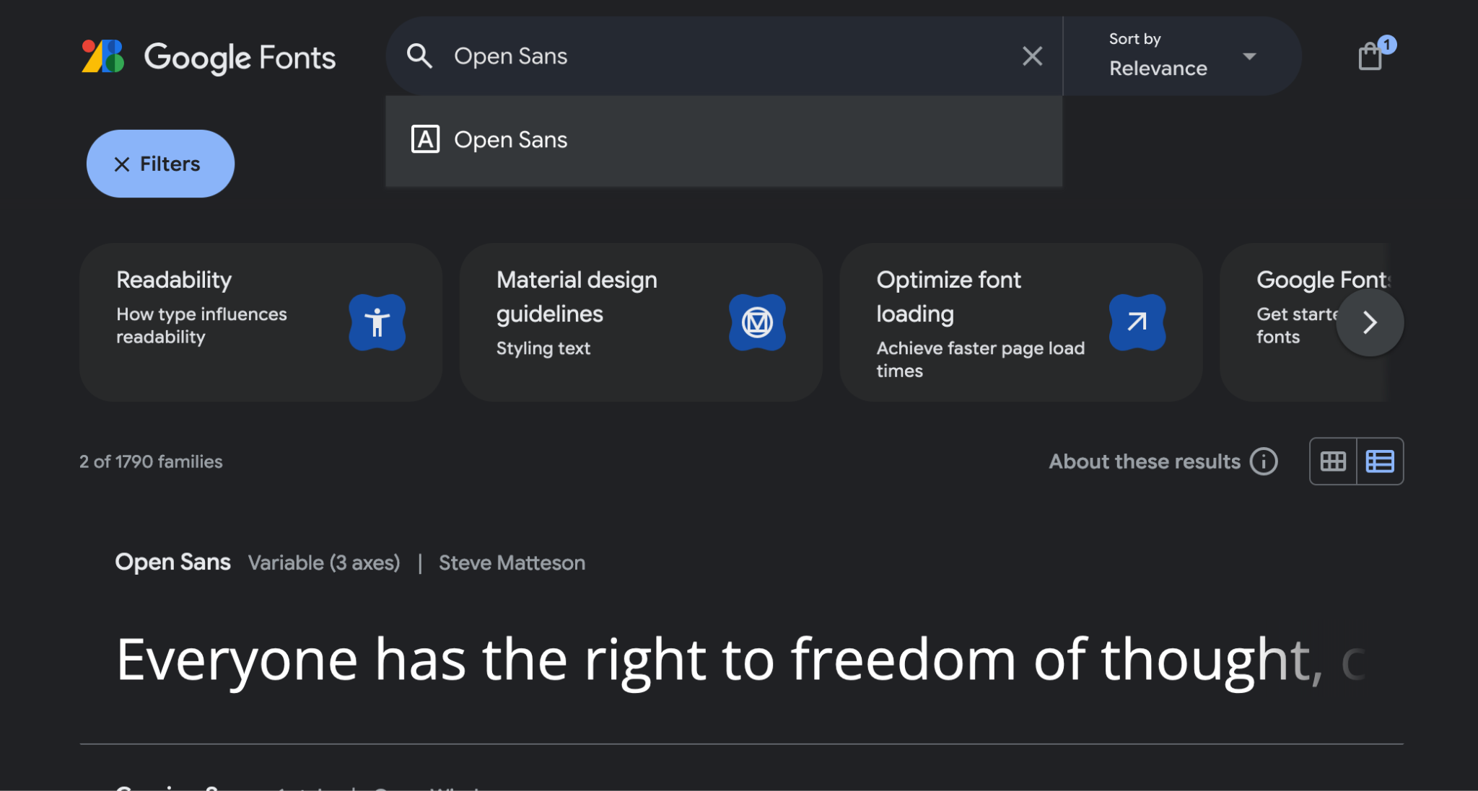
Importing Fonts
git reset --hard
git checkout w0-step4
fonts.google.com

Slide 56
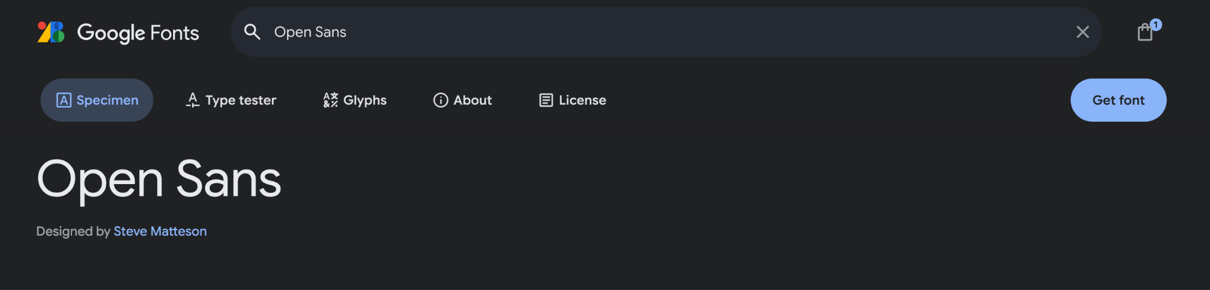
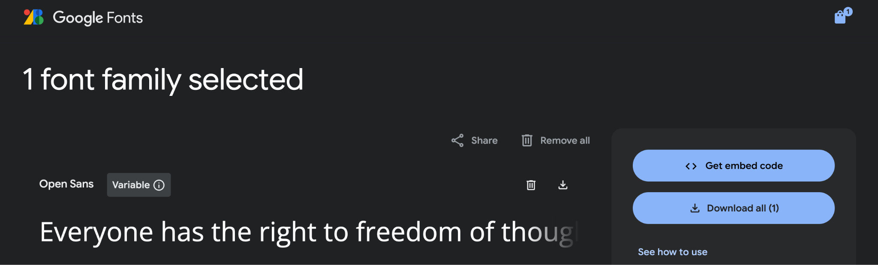
Importing Fonts
git reset --hard
git checkout w0-step4
fonts.google.com

Slide 57
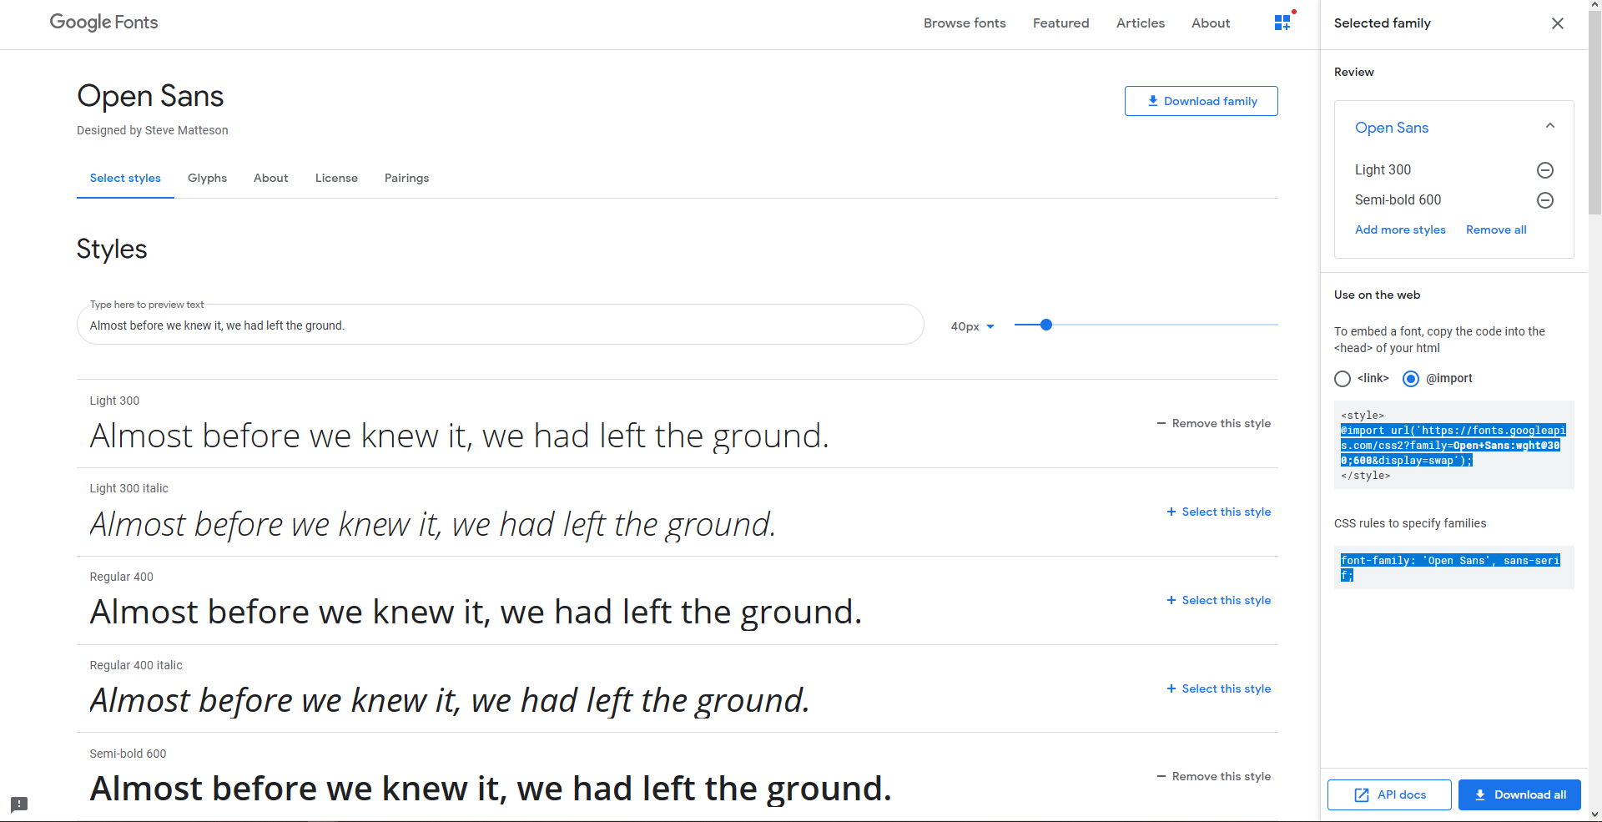
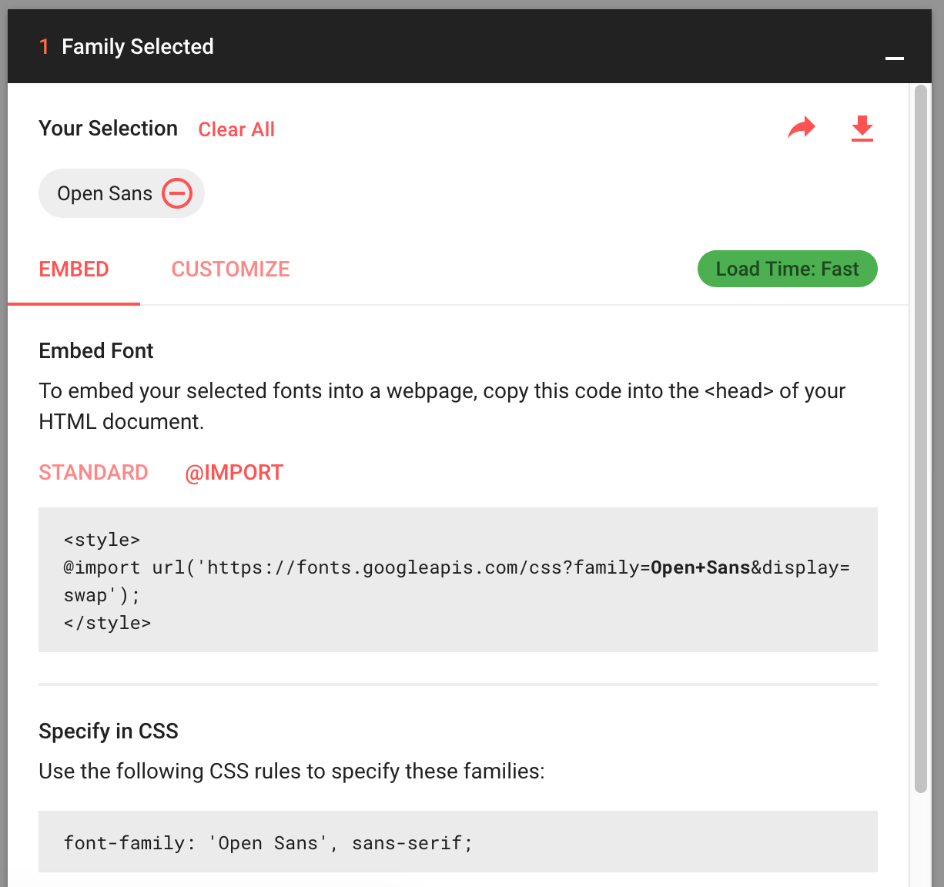
Importing Fonts
fonts.google.com
(2)
1a
3
1b
4

Slide 58

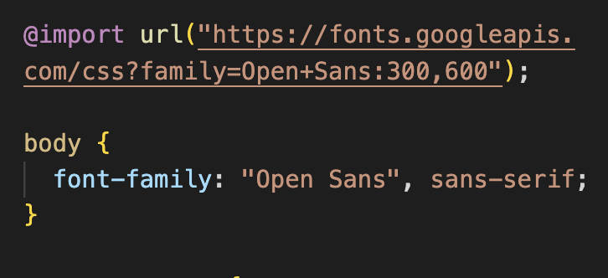
Importing Fonts
git reset --hard
git checkout w0-step4
paste into styles.css!

Slide 59
Step 5:
Adding a Navbar
git reset --hard
git checkout w0-step5
workshop 3 progress
workshop 0 progress
starter
starter
step1
step2
complete
complete

Slide 60
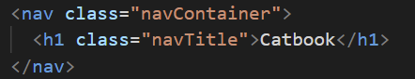
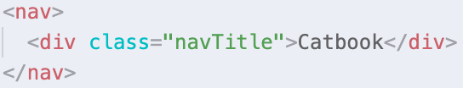
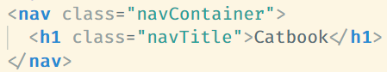
Adding a Navbar
git reset --hard
git checkout w0-step5
Let’s add the tag <nav> at the top for our navbar content.

Slide 61
Adding a Navbar
git reset --hard
git checkout w0-step5
Next, we’re gonna wanna style it colorful. But first, let’s define some colors!

Slide 62
CSS Variables
git reset --hard
git checkout w0-step5
CSS has CSS variables that can be defined and then used throughout.

Slide 63
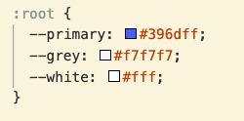
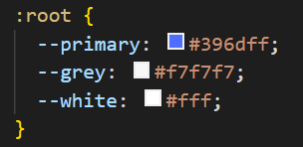
CSS Variables
git reset --hard
git checkout w0-step5
CSS has CSS variables that can be defined and then used throughout. We’ll define our colors as variables.

Slide 64
CSS Variables
git reset --hard
git checkout w0-step5
CSS has CSS variables that can be defined and then used throughout. We’ll define our colors as variables.
Notes:
Define variables in :root; to be noted: this isn’t actually styling anything it’s just defining variables

Slide 65
CSS Variables
git reset --hard
git checkout w0-step5
CSS has CSS variables that can be defined and then used throughout. We’ll define our colors as variables.
Notes:
variable names MUST begin with the double dash

Slide 66
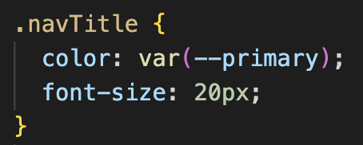
CSS Variables
git reset --hard
git checkout w0-step5
CSS has CSS variables that can be defined and then used throughout. We’ll define our colors as variables.
Notes:
names MUST begin with the double dash

Slide 67
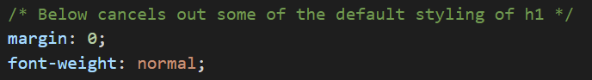
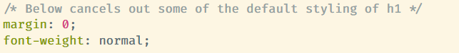
CSS Variables
git reset --hard
git checkout w0-step5
CSS has CSS variables that can be defined and then used throughout. We’ll define our colors as variables.
add this under .navTitle too!
Notes:
names MUST begin with the double dash

Slide 68
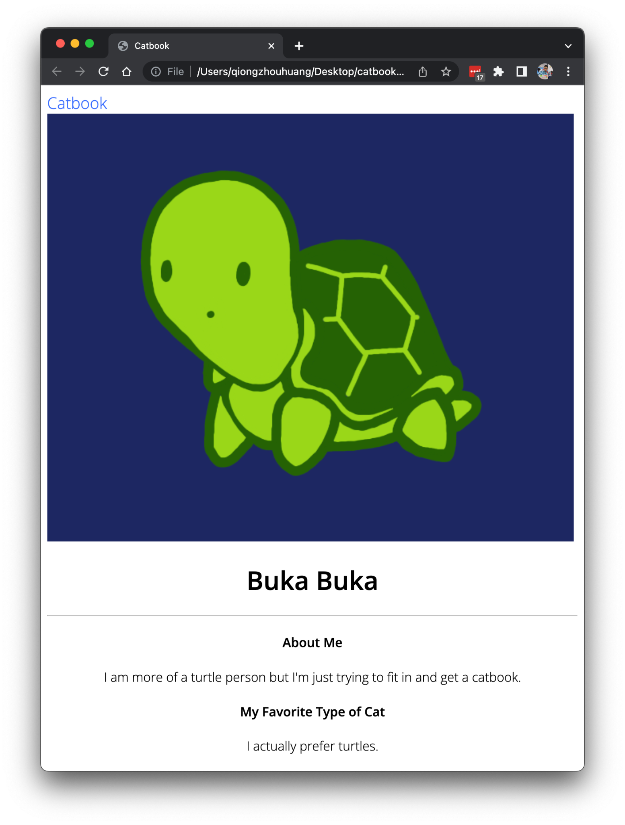
Adding a Navbar
git reset --hard
git checkout w0-step5
Try changing the color in :root and see the color change when you refresh the page!

Slide 69
Adding a Navbar
git reset --hard
git checkout w0-step5

Slide 70
Step 6:
Styling the NavBar
(Exercise!)
git reset --hard
git checkout w0-step6
workshop 3 progress
workshop 0 progress
starter
starter
step1
step2
complete
complete

Slide 71
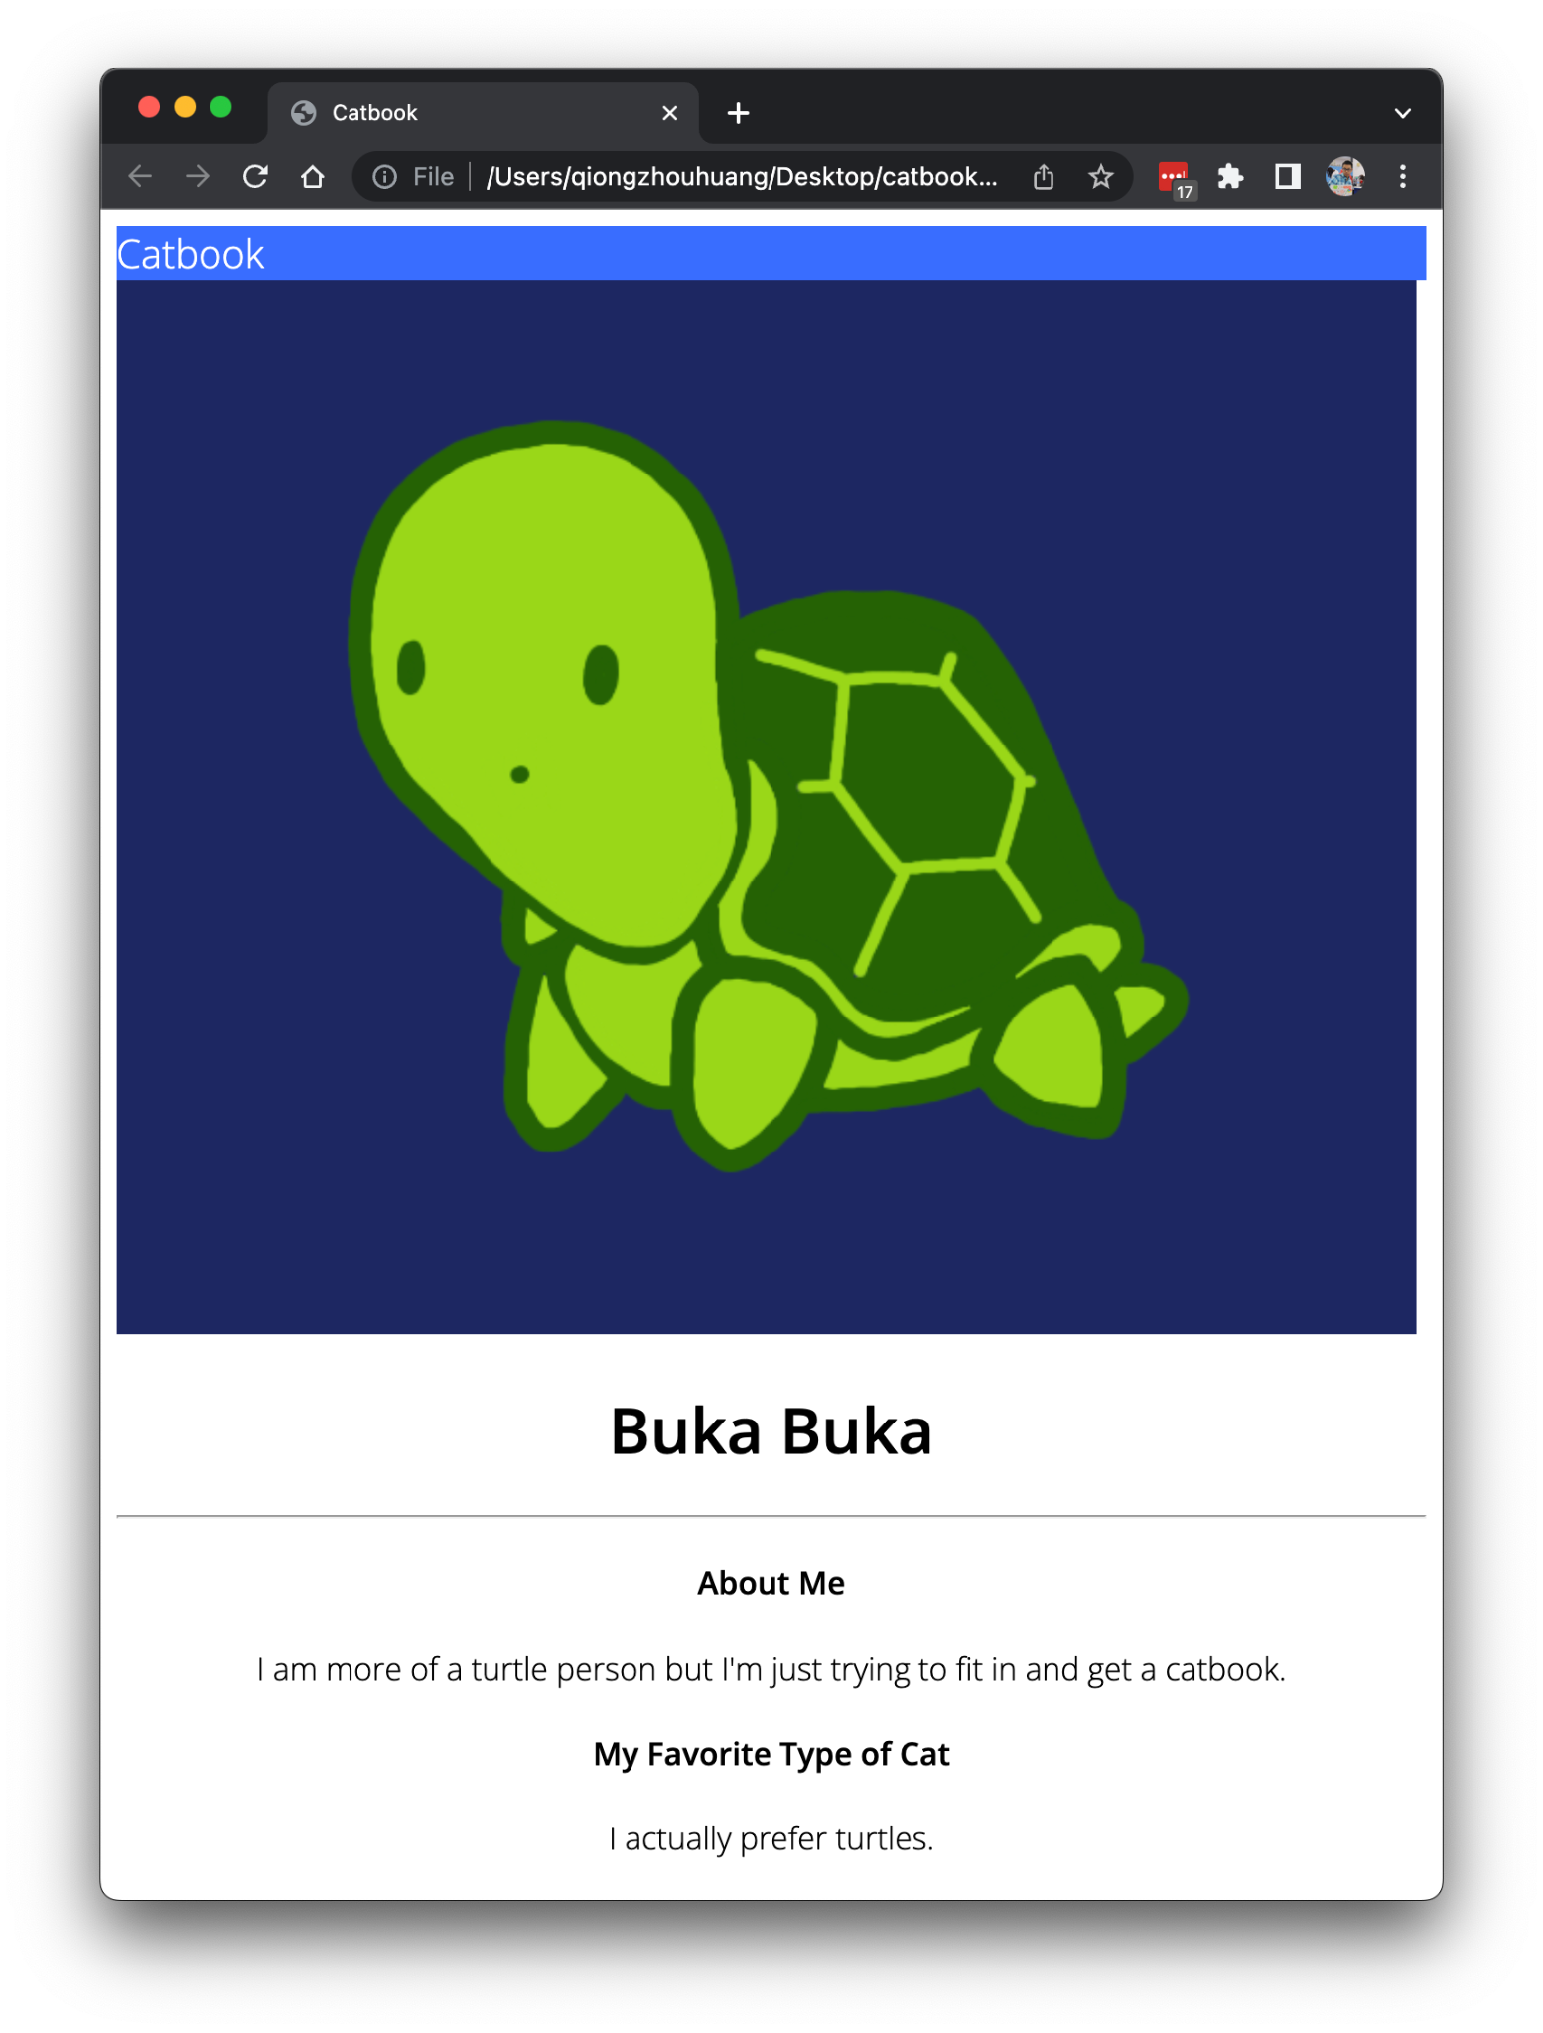
git reset --hard
git checkout w0-step6

Slide 72
Exercise 4
git reset --hard
git checkout w0-step6
Now try using those variables to style the nav bar!
Hint: you may need to create a new container class!

Slide 73
Quick Break!
take a bio break if you need it
but for everyone else…

Slide 74
Quick Break!
take a bio break if you need it
but for everyone else…
wall-sit competition >:)

Slide 75
Step 7:
Removing the margin
(Follow Along)
git reset --hard
git checkout w0-step7
workshop 3 progress
workshop 0 progress
starter
starter
step1
step2
complete
complete

Slide 76
git reset --hard
git checkout w0-step7

Slide 77
git reset --hard
git checkout w0-step7

Slide 78
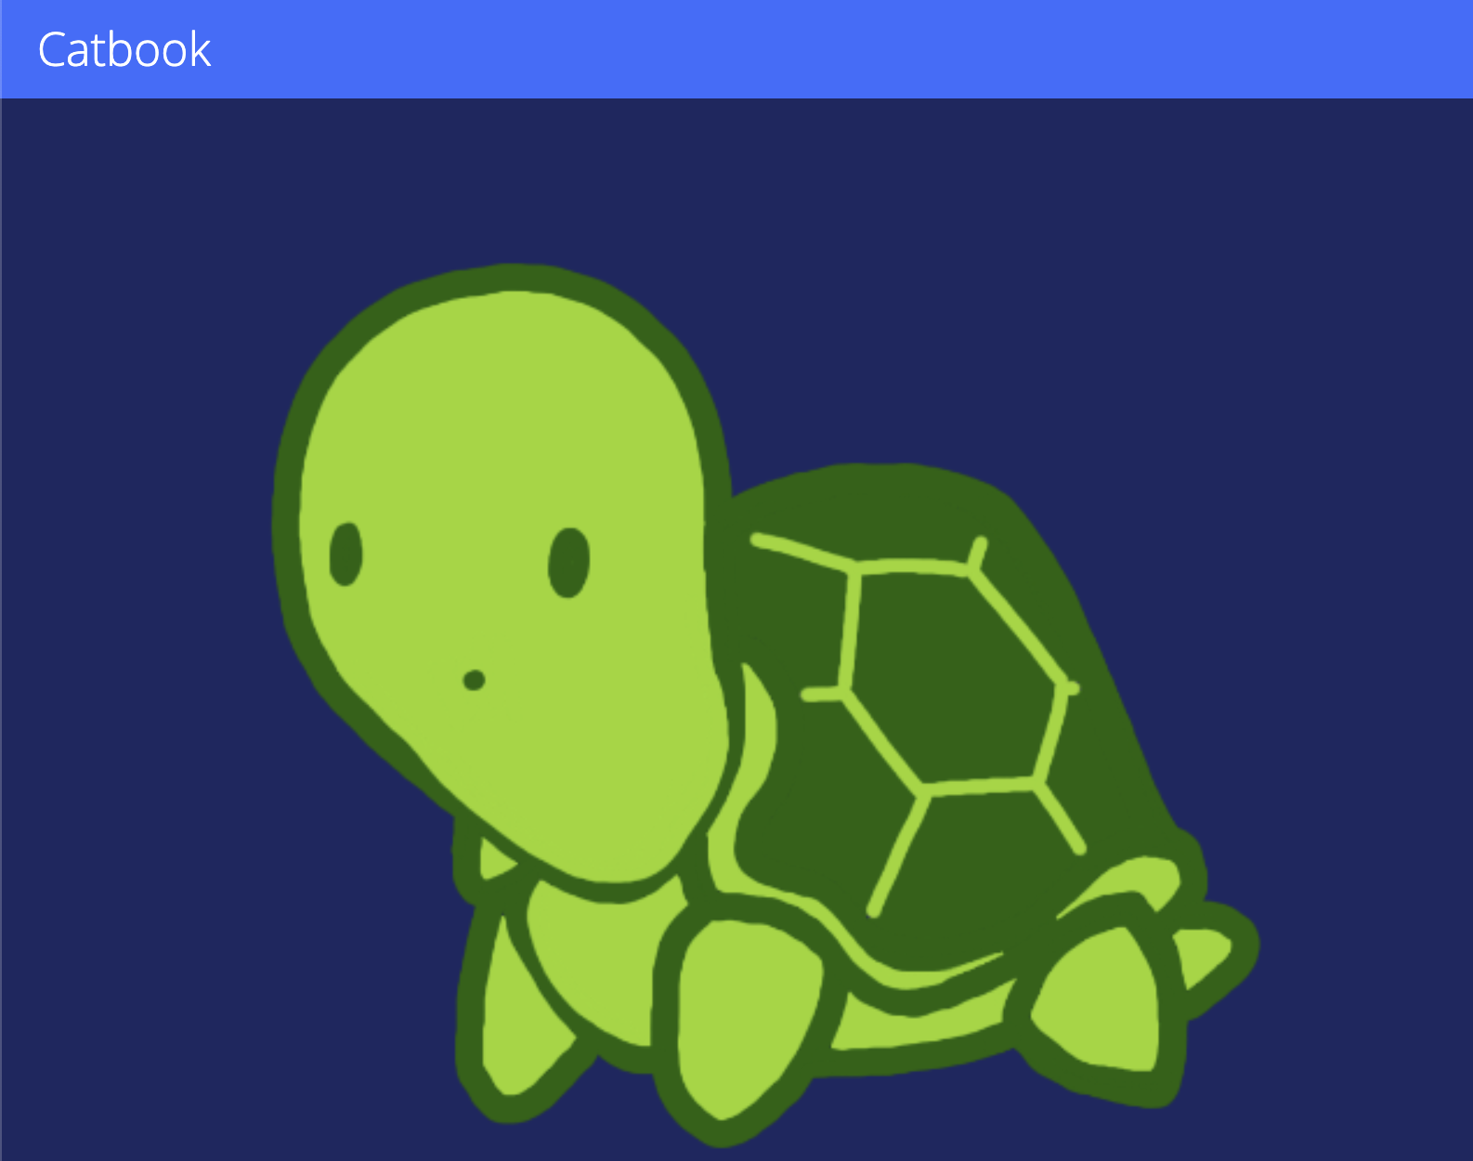
git reset --hard
git checkout w0-step7

Slide 79
We Need to Fill It.
Let’s inspect where this is coming from! 🔍

Slide 80
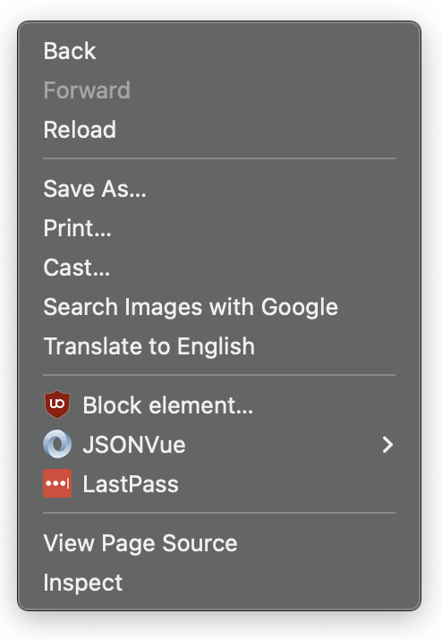
The Void
git reset --hard
git checkout w0-step7
Right click + click Inspect Element

Slide 81
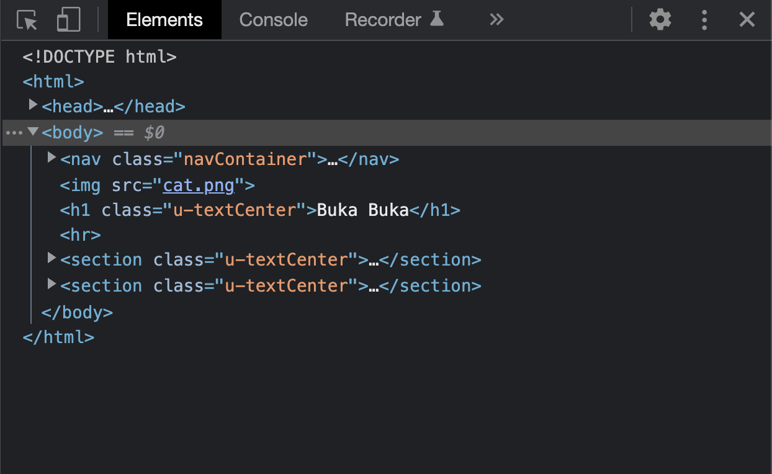
The Void
git reset --hard
git checkout w0-step7

Slide 82
The Void
git reset --hard
git checkout w0-step7

Slide 83
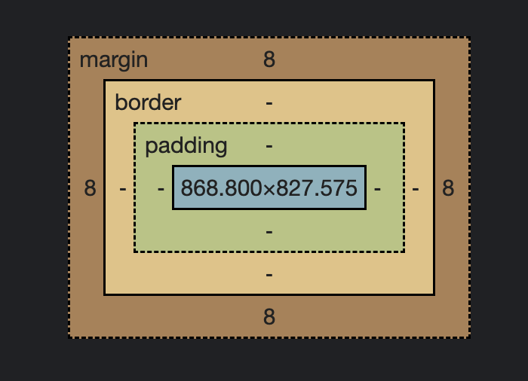
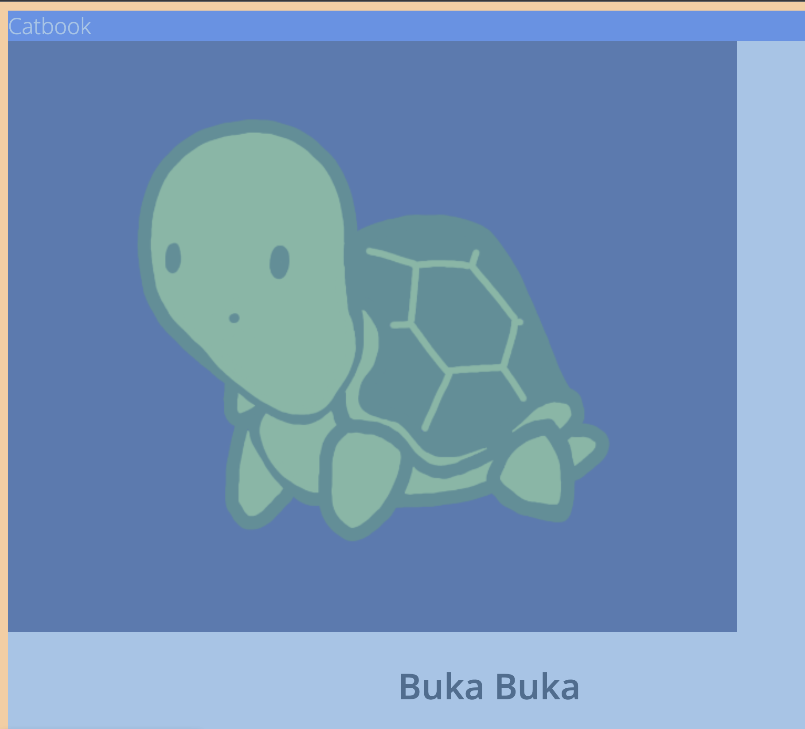
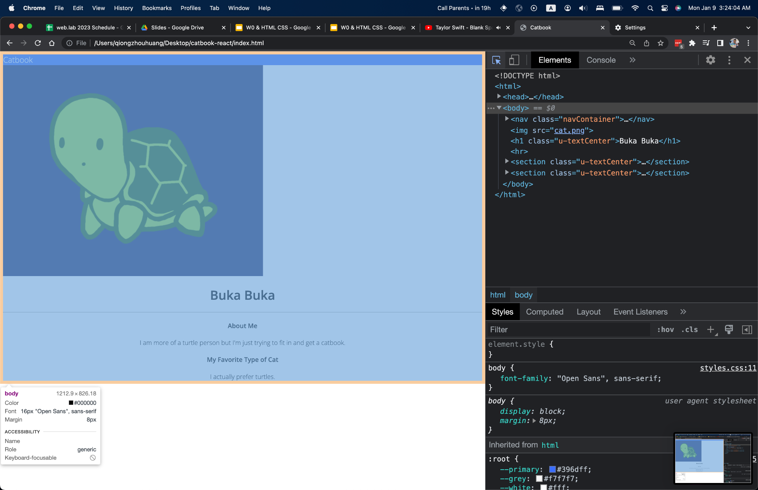
Margin
git reset --hard
git checkout w0-step7

Slide 84
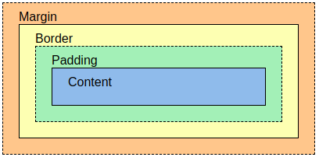
Box Model
git reset --hard
git checkout w0-step7
Notes:
Padding clears an area around the content, affected by background color
Margin is empty area beyond border, completely transparent

Slide 85
Box Model
git reset --hard
git checkout w0-step7
Notes:
Padding clears an area around the content, affected by background color
Margin is empty area beyond border, completely transparent

Slide 86
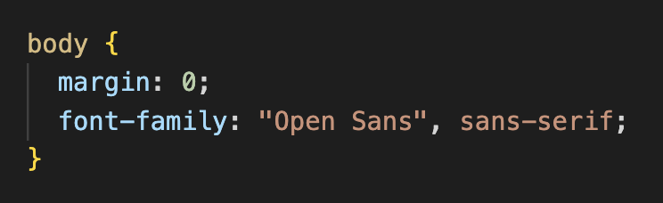
Margin
git reset --hard
git checkout w0-step7

Slide 87
Ordering
git reset --hard
git checkout w0-step7
Some CSS attributes can take multiple values, like padding and margin.

Slide 88
Ordering
git reset --hard
git checkout w0-step7
Some CSS attributes can take multiple values, like padding and margin.
margin: 10px;
10px
10px
10px
10px

Slide 89
Ordering
git reset --hard
git checkout w0-step7
Some CSS attributes can take multiple values, like padding and margin.
margin: 10px 20px;
10px
20px
20px
10px

Slide 90
Ordering
git reset --hard
git checkout w0-step7
Some CSS attributes can take multiple values, like padding and margin.
margin: 10px 20px 30px;
10px
20px
20px
30px

Slide 91
Ordering
git reset --hard
git checkout w0-step7
Some CSS attributes can take multiple values, like padding and margin.
margin: 10px 20px 30px 40px;
10px
40px
20px
30px

Slide 92
Ordering
Some CSS attributes can take multiple values, like padding and margin.
1
1, 2, 4
1, 2
1, 3

Slide 93
Blank Space
git reset --hard
git checkout w0-step7
Notes:
One approach is we could just assign some px values to create padding space

Slide 94


Padding
git reset --hard
git checkout w0-step7
Notes:
One approach is we could just assign some px values to create padding space

Slide 95
Padding
git reset --hard
git checkout w0-step7
We could arbitrarily add some px padding, but...

Slide 96
8pt Grid System
git reset --hard
git checkout w0-step7
Notes:
But we’ll be using something called the 8pt grid system
this isn’t necessary to use, but it’s a really simple way to organize the visuals of your site

Slide 97

8pt Grid System
git reset --hard
git checkout w0-step7
Notes:
if you’re interested in more reading about this, there’s a few articles online you can find including this: https://builttoadapt.io/intro-to-the-8-point-grid-system-d2573cde8632

Slide 98

8pt Grid System
git reset --hard
git checkout w0-step7
Notes:
We’ve modified it a little bit to be pixels

Slide 99

8pt Grid System
git reset --hard
git checkout w0-step7
Notes:
We’ve modified it a little bit to be pixels ORDERING>..

Slide 100

Width and Height
Affect size of CONTENT!
width: 100px;
height: 50px;

Slide 101

Blank Space
git checkout w0-step8

Slide 102
Step 8:
Rounding corners
(Exercise!)
git reset --hard
git checkout w0-step8
workshop 3 progress
workshop 0 progress
starter
starter
step1
step2
complete
complete

Slide 103

git reset --hard
git checkout w0-step8

Slide 104

Exercise 5
git reset --hard
git checkout w0-step8
Let’s talk about border-radius

Slide 105
Exercise 5
git reset --hard
git checkout w0-step8
Using the variables we defined for the 8pt system, try rounding the corners of your profile picture.

Slide 106
Exercise 5
git reset --hard
git checkout w0-step8
git checkout w0-step9

Slide 107
Step 9:
Perfect circle
(Exercise!)
git reset --hard
git checkout w0-step9
workshop 3 progress
workshop 0 progress
starter
starter
step1
step2
complete
complete

Slide 108

Exercise 6
git reset --hard
git checkout w0-step9
Can you make it perfectly round?

Slide 109
Exercise 6
git reset --hard
git checkout w0-step9
But can you make it perfectly round?
Use the internet!
git checkout w0-step10
or you can just look at our code :P

Slide 110
Step 10:
Horizontal Format
git reset --hard
git checkout w0-step10
workshop 3 progress
workshop 0 progress
starter
starter
step1
step2
complete
complete

Slide 111



So Close!
git reset --hard
git checkout w0-step10

Slide 112
So Close!
git reset --hard
git checkout w0-step10

Slide 113

Notes:
tl;dr: w3schools bad

Slide 114
Notes:
tl;dr: w3schools bad

Slide 115

Flex
weblab.is/flex
git reset --hard
git checkout w0-step10
Flexbox is a flexible box that lets you control the direction, sizing, distribution, and more of items.
Notes:
Worthwhile read:
https://css-tricks.com/snippets/css/a-guide-to-flexbox/

Slide 116
Flex
git reset --hard
git checkout w0-step10
Flexbox is a flexible box that lets you control the direction, sizing, distribution, and more of items.

Slide 117


Flex
git reset --hard
git checkout w0-step10
Notes:
ask students for which flex attribute to edit

Slide 118
Flex
git reset --hard
git checkout w0-step10
Let’s just try adding a flex box around those sections!

Slide 119

Flex
git checkout w0-step11

Slide 120
Step 11:
Box sizing
git reset --hard
git checkout w0-step11
workshop 3 progress
workshop 0 progress
starter
starter
step1
step2
complete
complete

Slide 121

Flex 💪🏼
Hmmm
Notes:
Hint: https://css-tricks.com/snippets/css/a-guide-to-flexbox/

Slide 122

Flex 💪🏼
Flexbox is a flexible box that lets you control the direction, sizing, distribution, and more of items.

Slide 123
flex-basis 💪🏼
We can define the “default” size of items.

Slide 124
flex-grow 💪🏼
We can define what items gets to take up more space.

Slide 125

Exercise 7
Using this overview and weblab.is/flex🧂, try and make the columns the same size
Notes:
https://css-tricks.com/snippets/css/a-guide-to-flexbox/
Hint: What’s a container here? What’s a subcontainer.
Use Flex Grow

Slide 126
Exercise 7
git checkout w0-step12

Slide 127
Congrats!
You just finished your first workshop!
Learning HTML and CSS can be a an incremental process, but we hope this workshop introduced you to a variety of useful topics
Notes:
And honestly we did a lot

Slide 128
Flexing is Hard
We recommend the guide linked in: weblab.is/flex
And these games:
https://flexboxfroggy.com/ - good for learning 🐸
http://www.flexboxdefense.com/ - good for flex 💪🏼

Slide 129
Touch it Up!
We have some homework lined up for you to practice some simpler styling:
git checkout w0-step13
If you want to peek the answers later:
git checkout w0-complete

Slide 130
Learn more CSS in the Advanced CSS lecture next week!!

Slide 131
Feedback Time!
weblab.is/feedback

